Slide 1
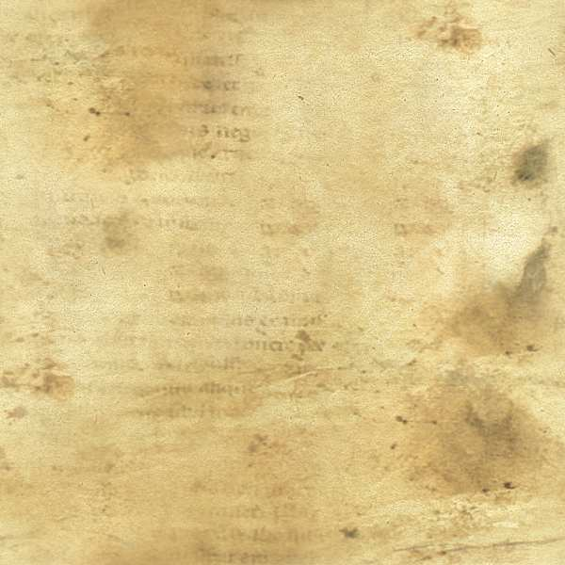
The Days of Noah
Matt 24:37-39
As the days of Noe were, so shall also the presence of the Son of man be.
For as in the days that were before the flood they were eating and drinking, marrying and giving in marriage, until the day that Noe entered into the ark,
And knew not until the flood came, and took them all away; so shall also the presence of the Son of man be.

Slide 2

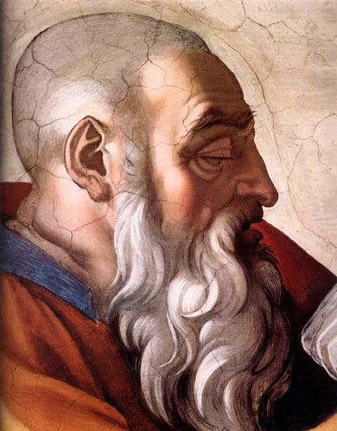
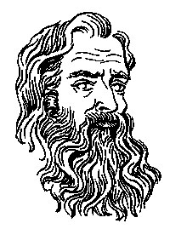
Gen 6:8-9
Noah found grace in the eyes of the LORD.
These are the generations of Noah: Noah was a just man and perfect in his generations, and Noah walked with God.

Slide 3
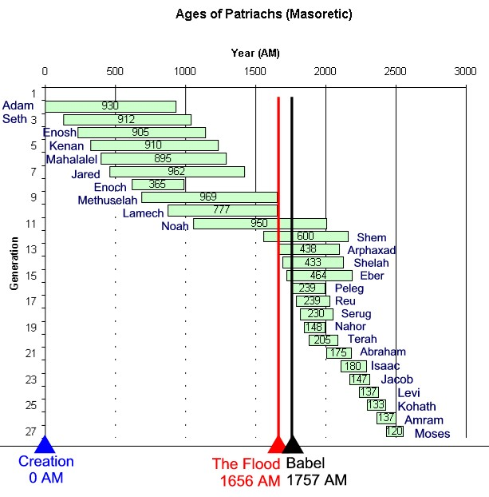
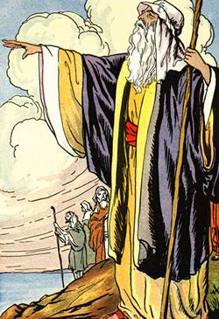

Slide 4
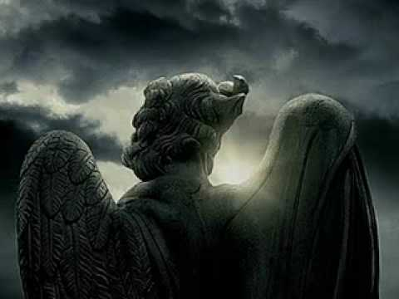
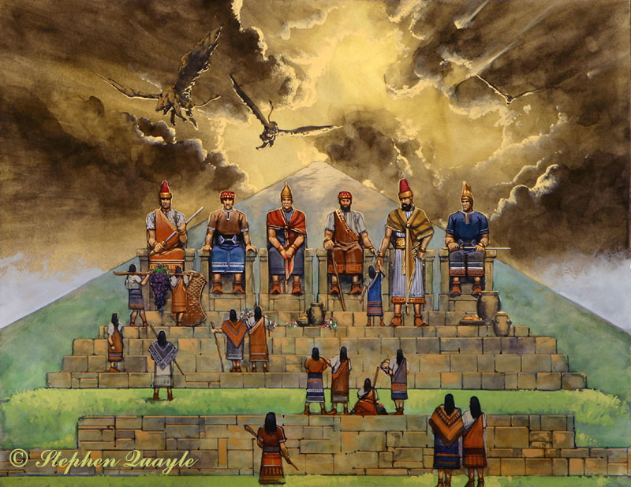
Gen 6:4
There were giants in the earth in those days; and also after that, when the sons of God came in unto the daughters of men,
and they bare children to them, the same became mighty men which were of old, men of renown.

Slide 5
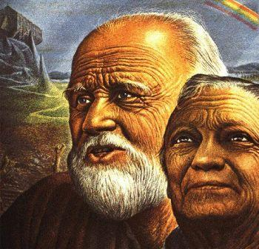
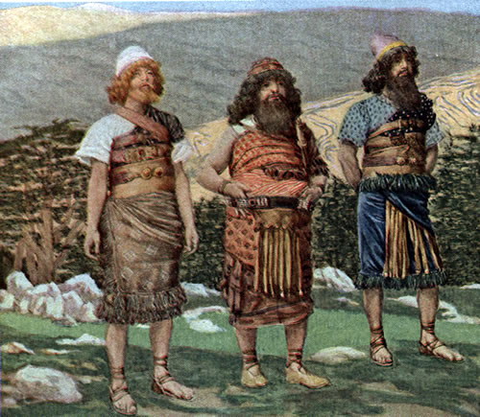
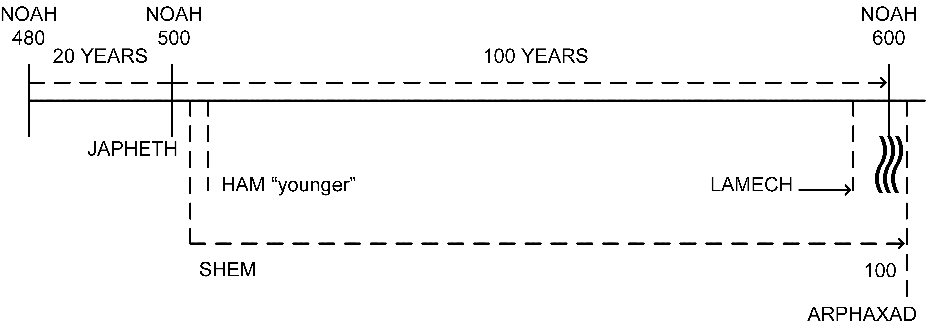
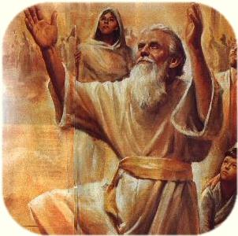

Gen 5:32
And Noah was five hundred years old: and Noah begat Shem, Ham, and Japheth.

Slide 6
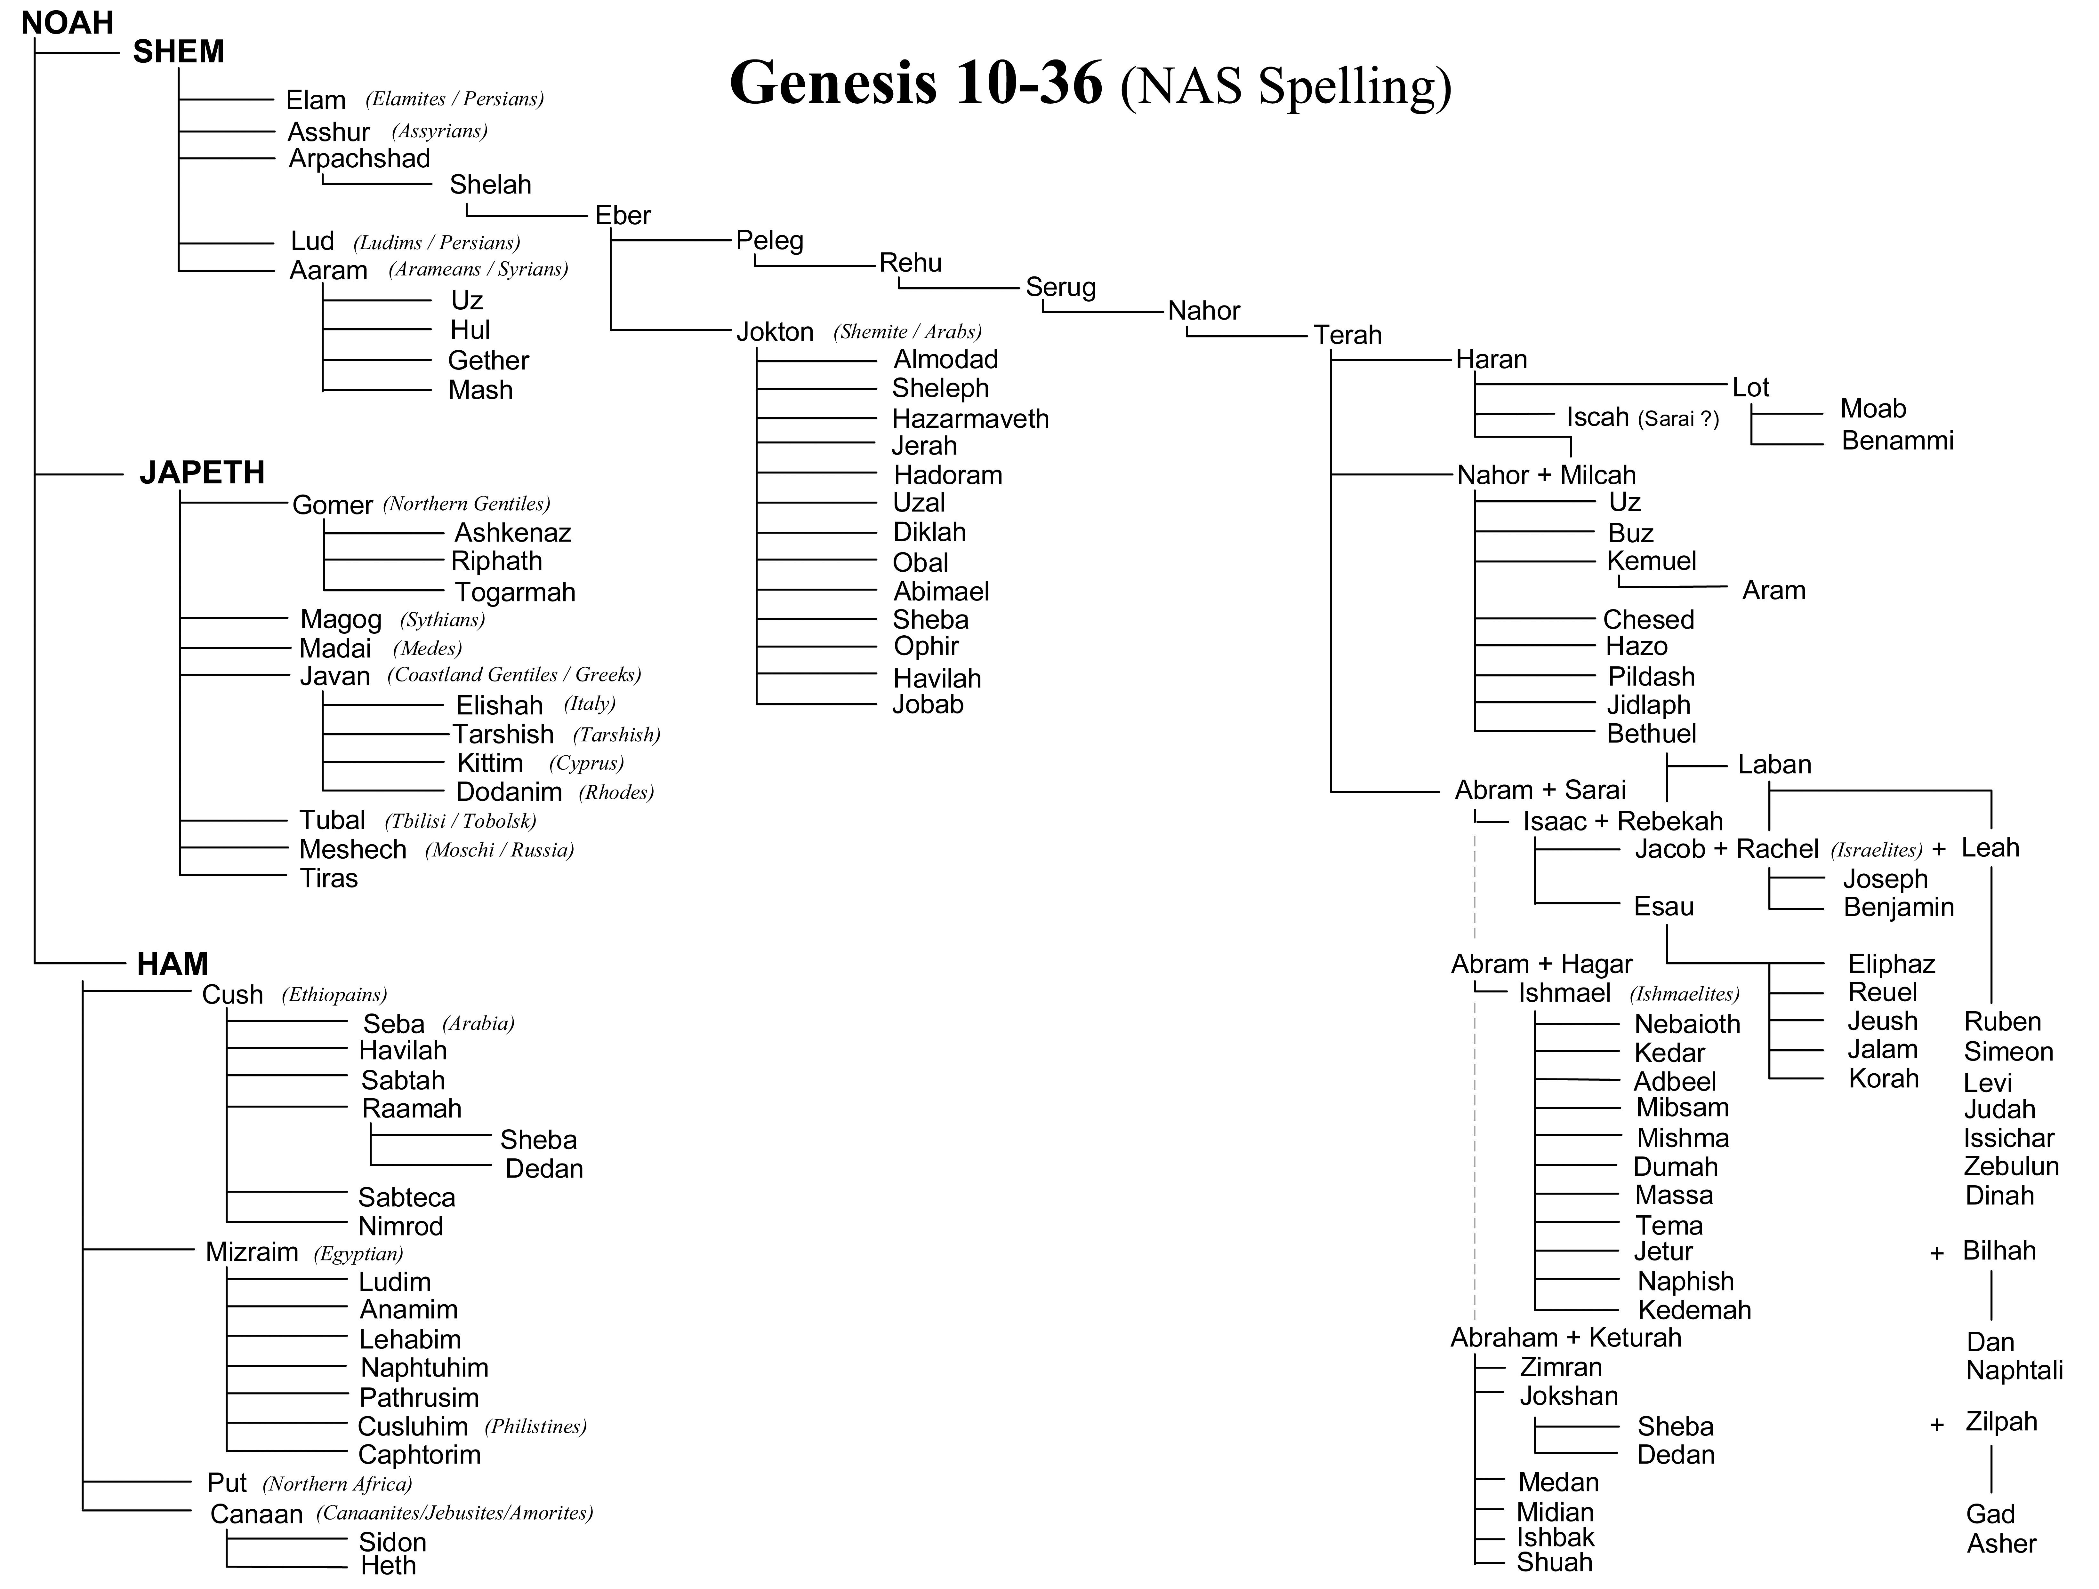
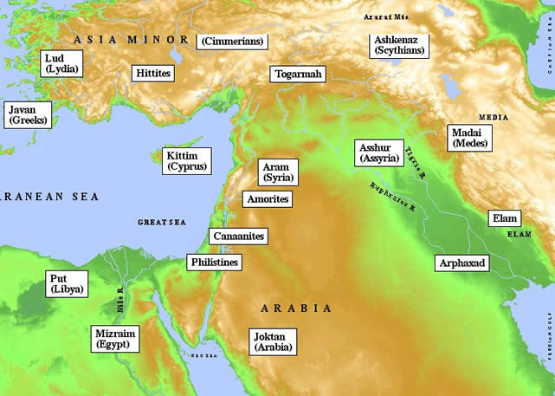


Slide 7
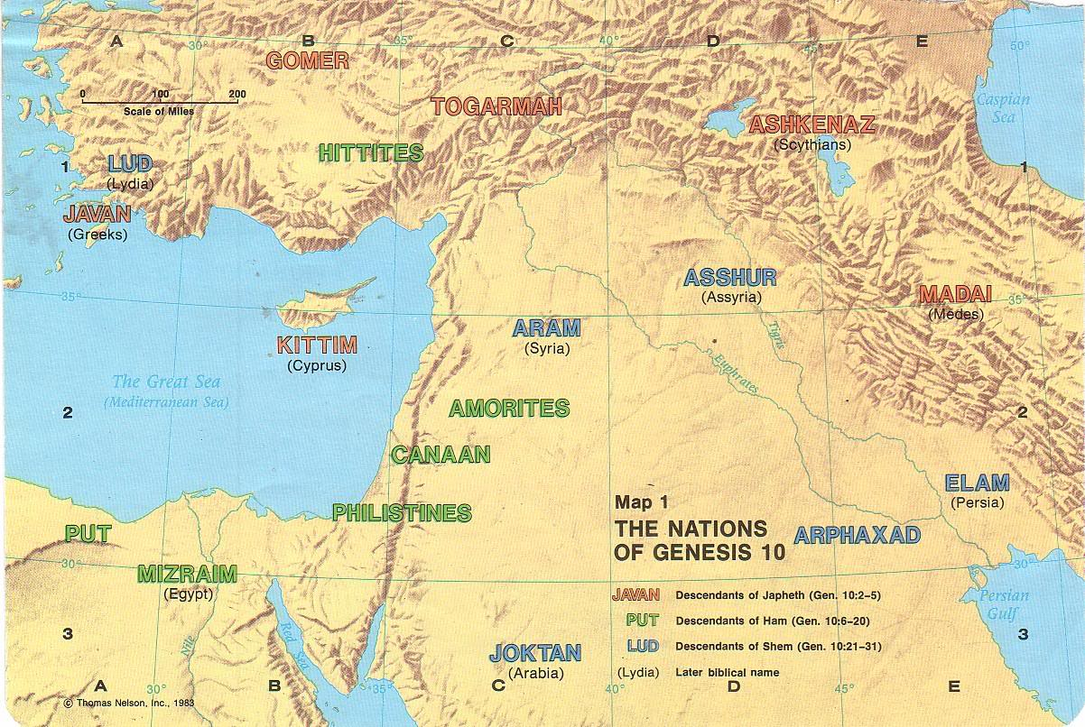

Slide 8
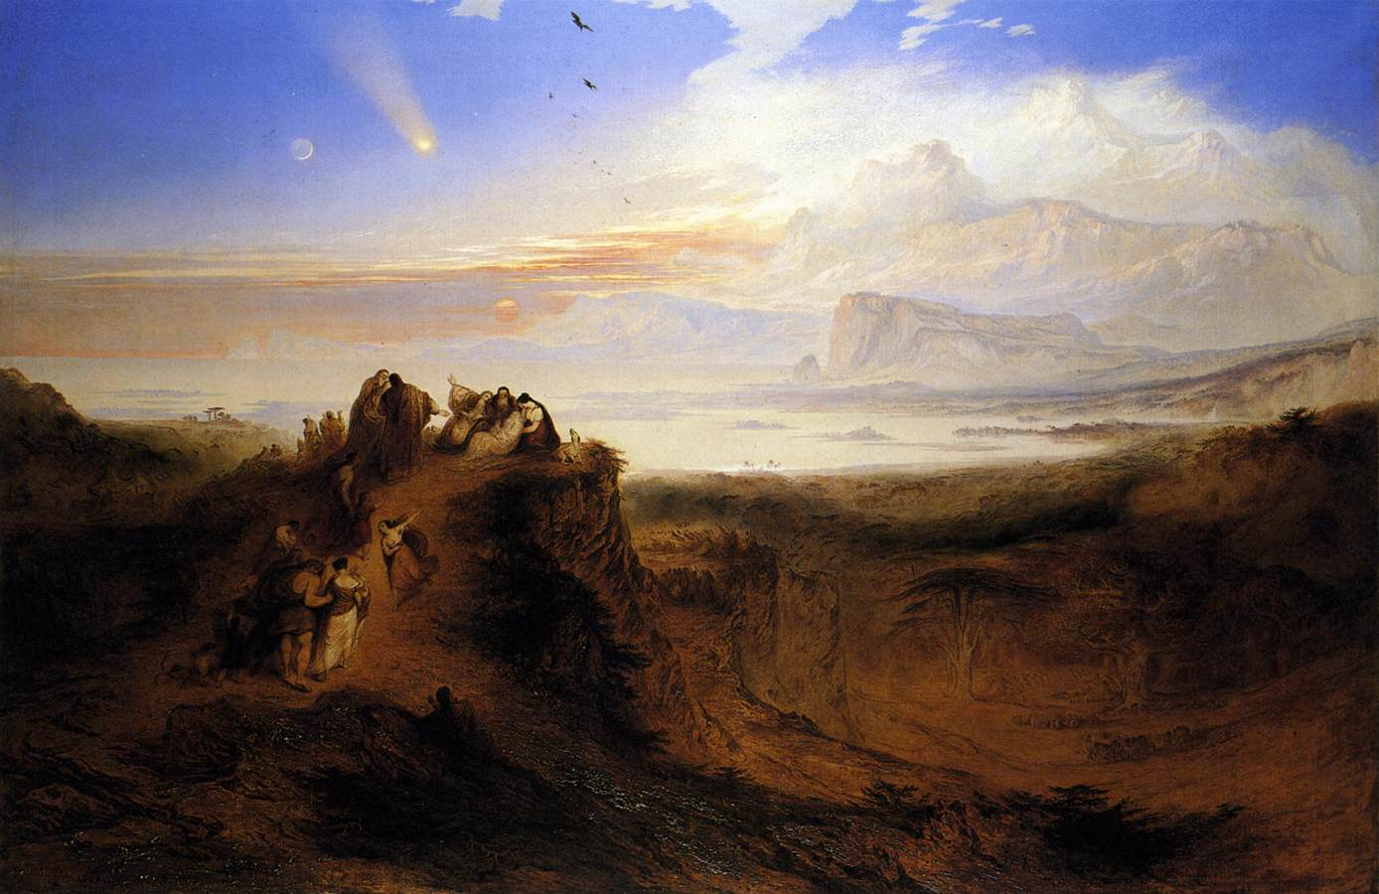
Gen 6:3
The Lord said, My Spirit shall not always strive with man, for that he also is flesh: yet his days shall be an 120 years.

Slide 9
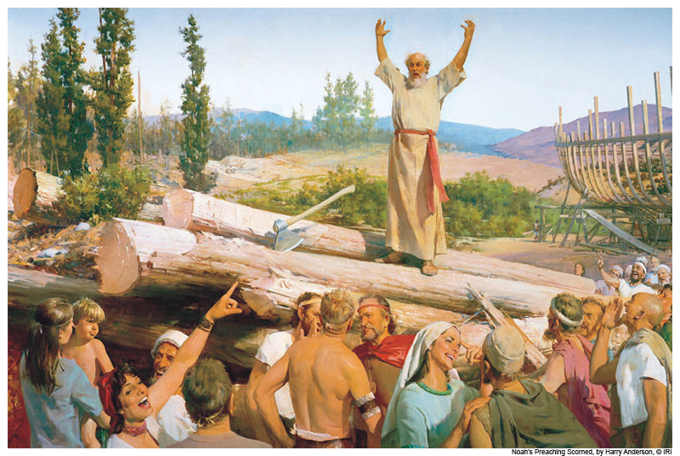

Slide 10
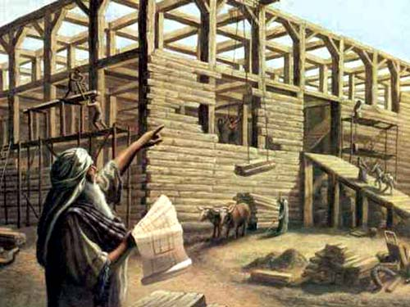
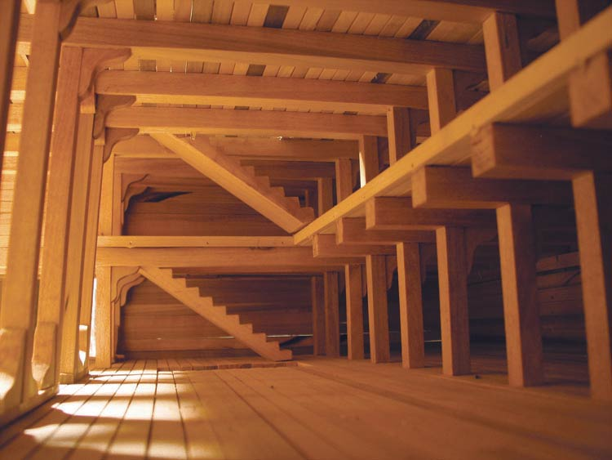
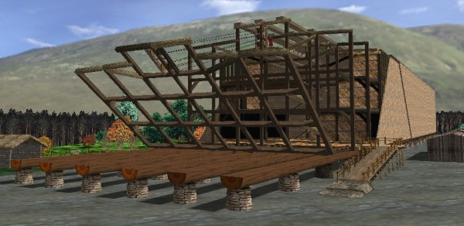
Gen 6:15
The length of the ark shall be 300 cubits: the breadth of it 50 cubits, and the height of it 30 cubits.

Slide 11

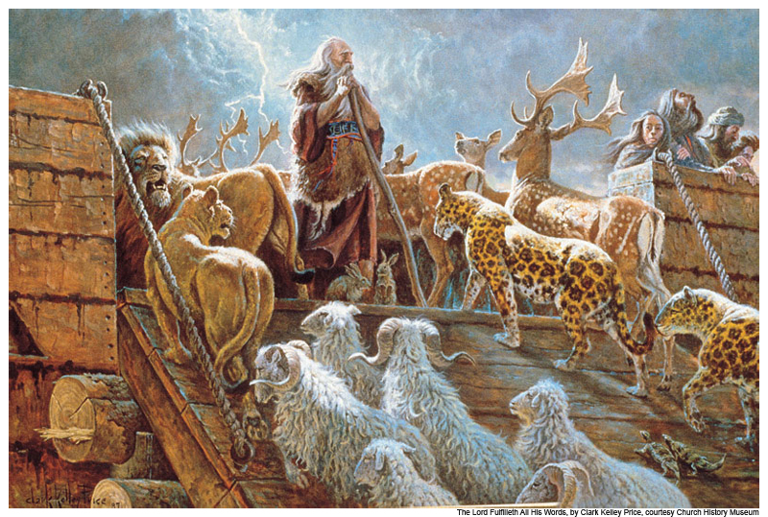
Gen 6:20 Of the birds according to their kinds, and of the animals according to their kinds, of every creeping thing of the ground, according to its kind, two of every sort shall come in to you to keep them alive.

Slide 14
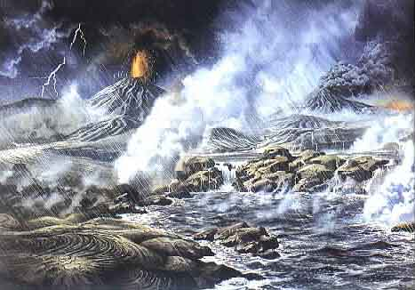
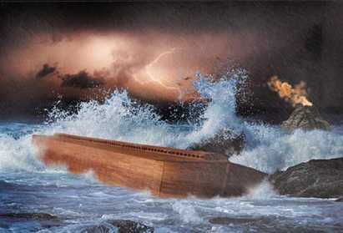
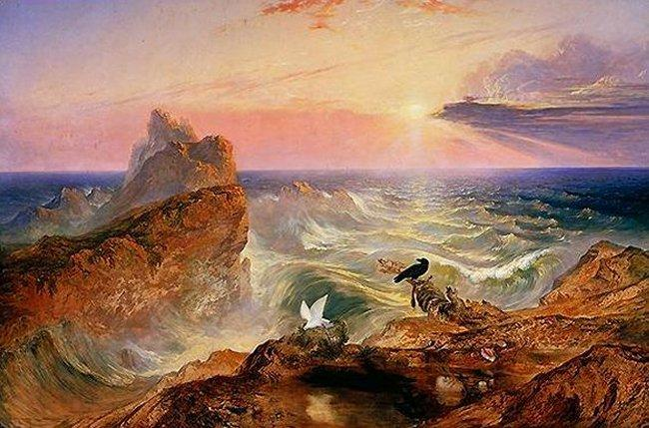
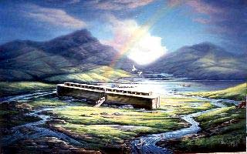

Slide 15
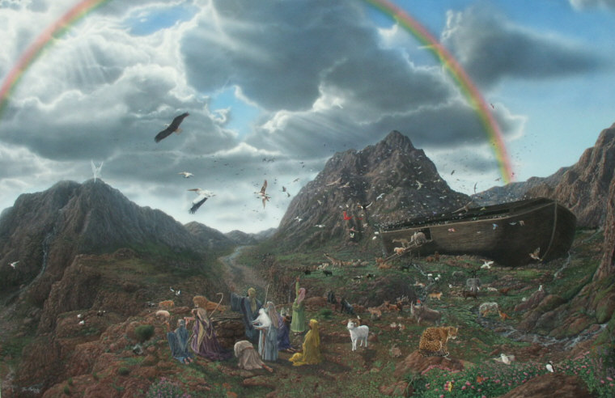

Slide 16
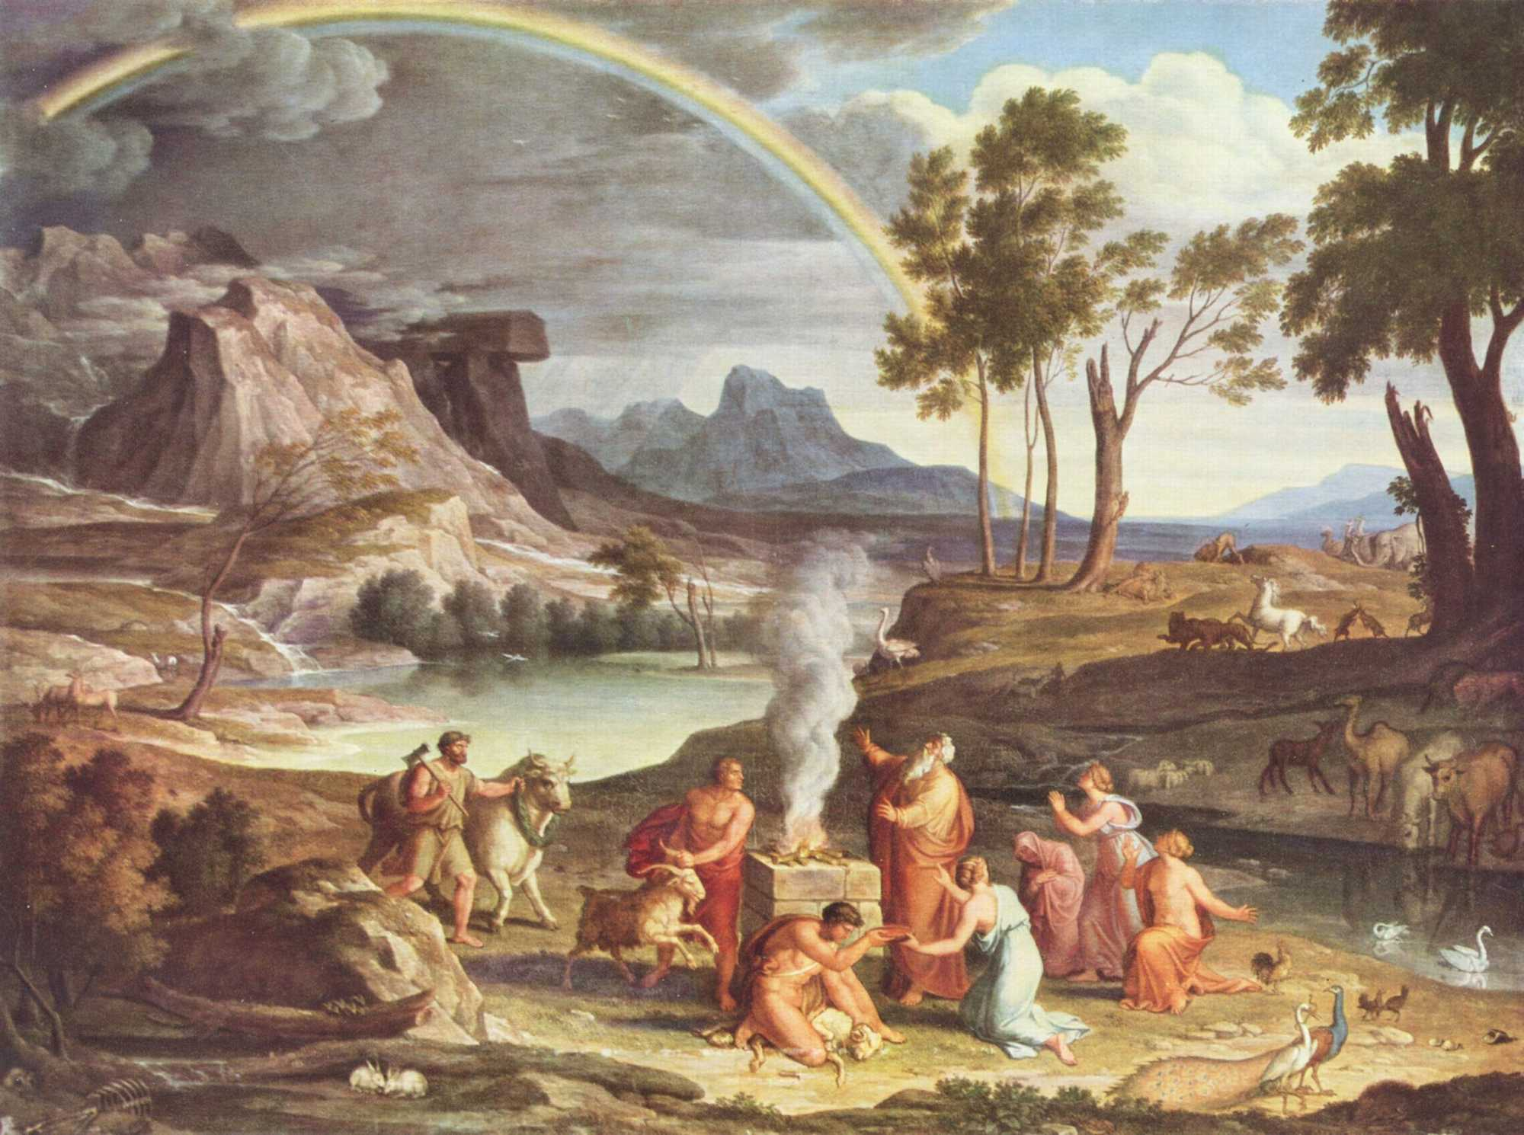
Gen 8:20-21; 9:9
Then Noah built an altar to the LORD and took some of every clean animal and some of every clean bird and offered burnt offerings on the altar.
And when the LORD smelled the pleasing aroma, the LORD said in his heart, "I will never again curse the ground because of man… Neither will I ever again strike down every living creature as I have done…
Behold I establish my covenant with you, and with your seed after you."

Slide 17

Mat 24:37-39 (Y) and as the days of Noah--so shall be also the presence of the Son of Man; for as they were, in the days before the flood, eating, and drinking, marrying, and giving in marriage, till the day Noah entered into the ark, and they did not know till the flood came and took all away; so shall be also the presence of the Son of Man.
Heb 11:7 (Y) By faith Noah, having been divinely warned concerning the things not yet seen, having feared, did prepare an ark to the salvation of his house, through which he did condemn the world, and of the righteousness according to faith he became heir.
1Pe 3:19-20 (Y) in which also to the spirits in prison having gone he did preach, who sometime disbelieved, when once the long-suffering of God did wait, in days of Noah--an ark being prepared--in which few, that is, eight souls, were saved through water.

Slide 18
2Pe 2:4-5 For if God spared not the angels that sinned, but cast them down to hell, and delivered them into chains of darkness, to be reserved unto judgment;
And spared not the old world, but saved Noah the eighth person, a preacher of righteousness, bringing in the flood upon the world of the ungodly;
2Pe 3:4-7 (E) They will say, "Where is the promise of his coming? For ever since the fathers fell asleep, all things are continuing as they were from the beginning of creation." For they deliberately overlook this fact, that the heavens existed long ago, and the earth was formed out of water and through water by the word of God, and that by means of these the world that then existed was deluged with water and perished. But by the same word the heavens and earth that now exist are stored up for fire, being kept until the day of judgment and destruction of the ungodly.

Slide 19

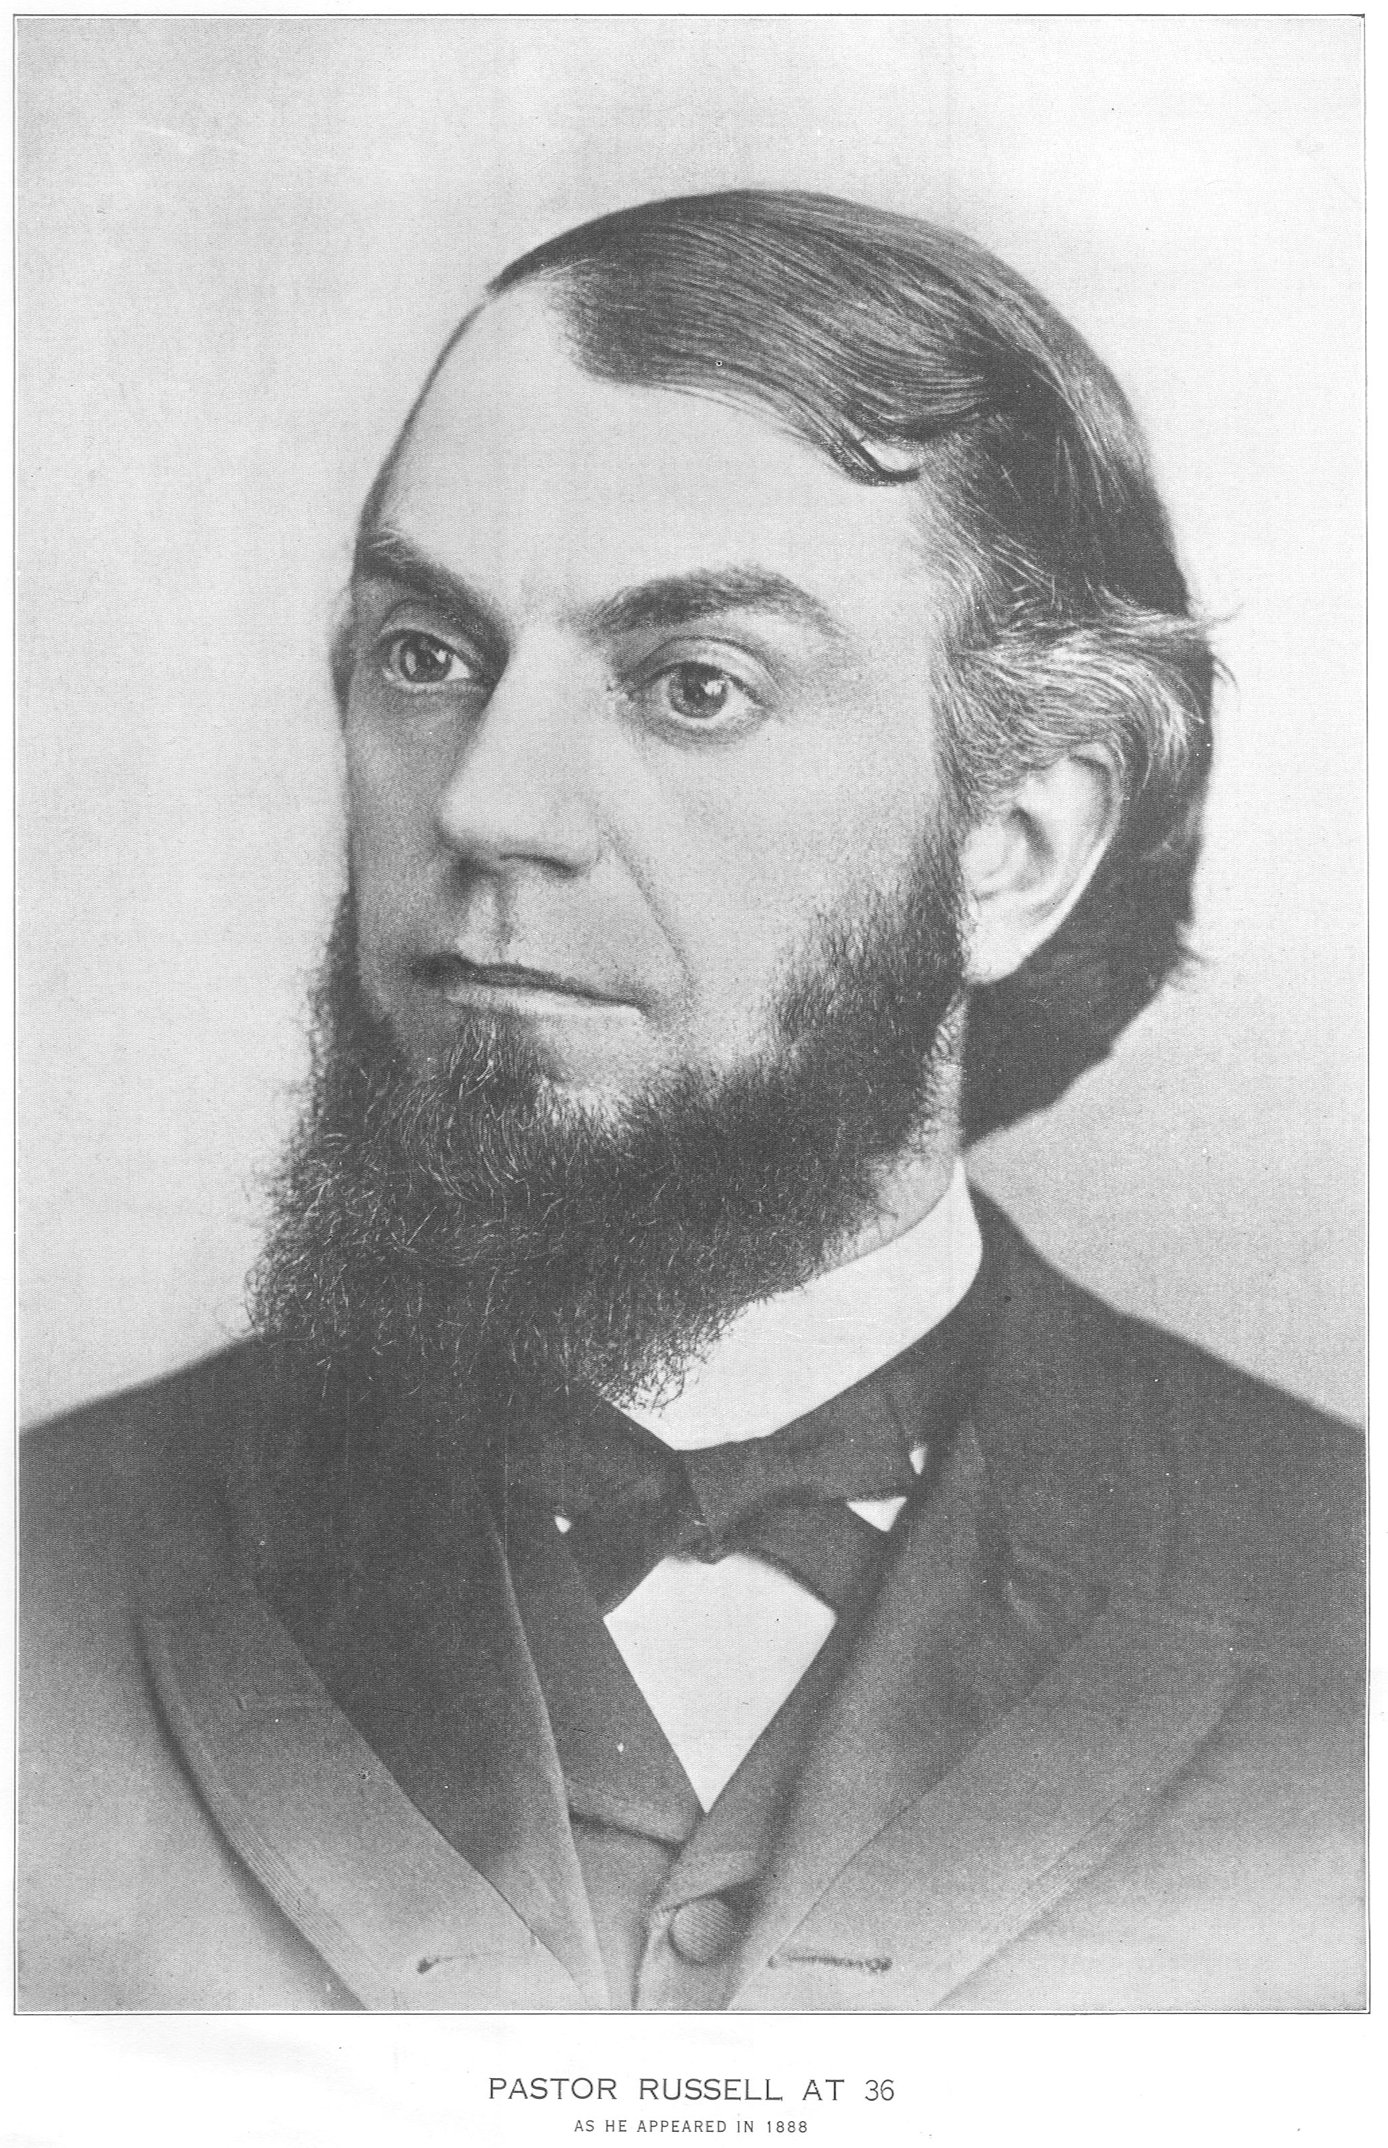
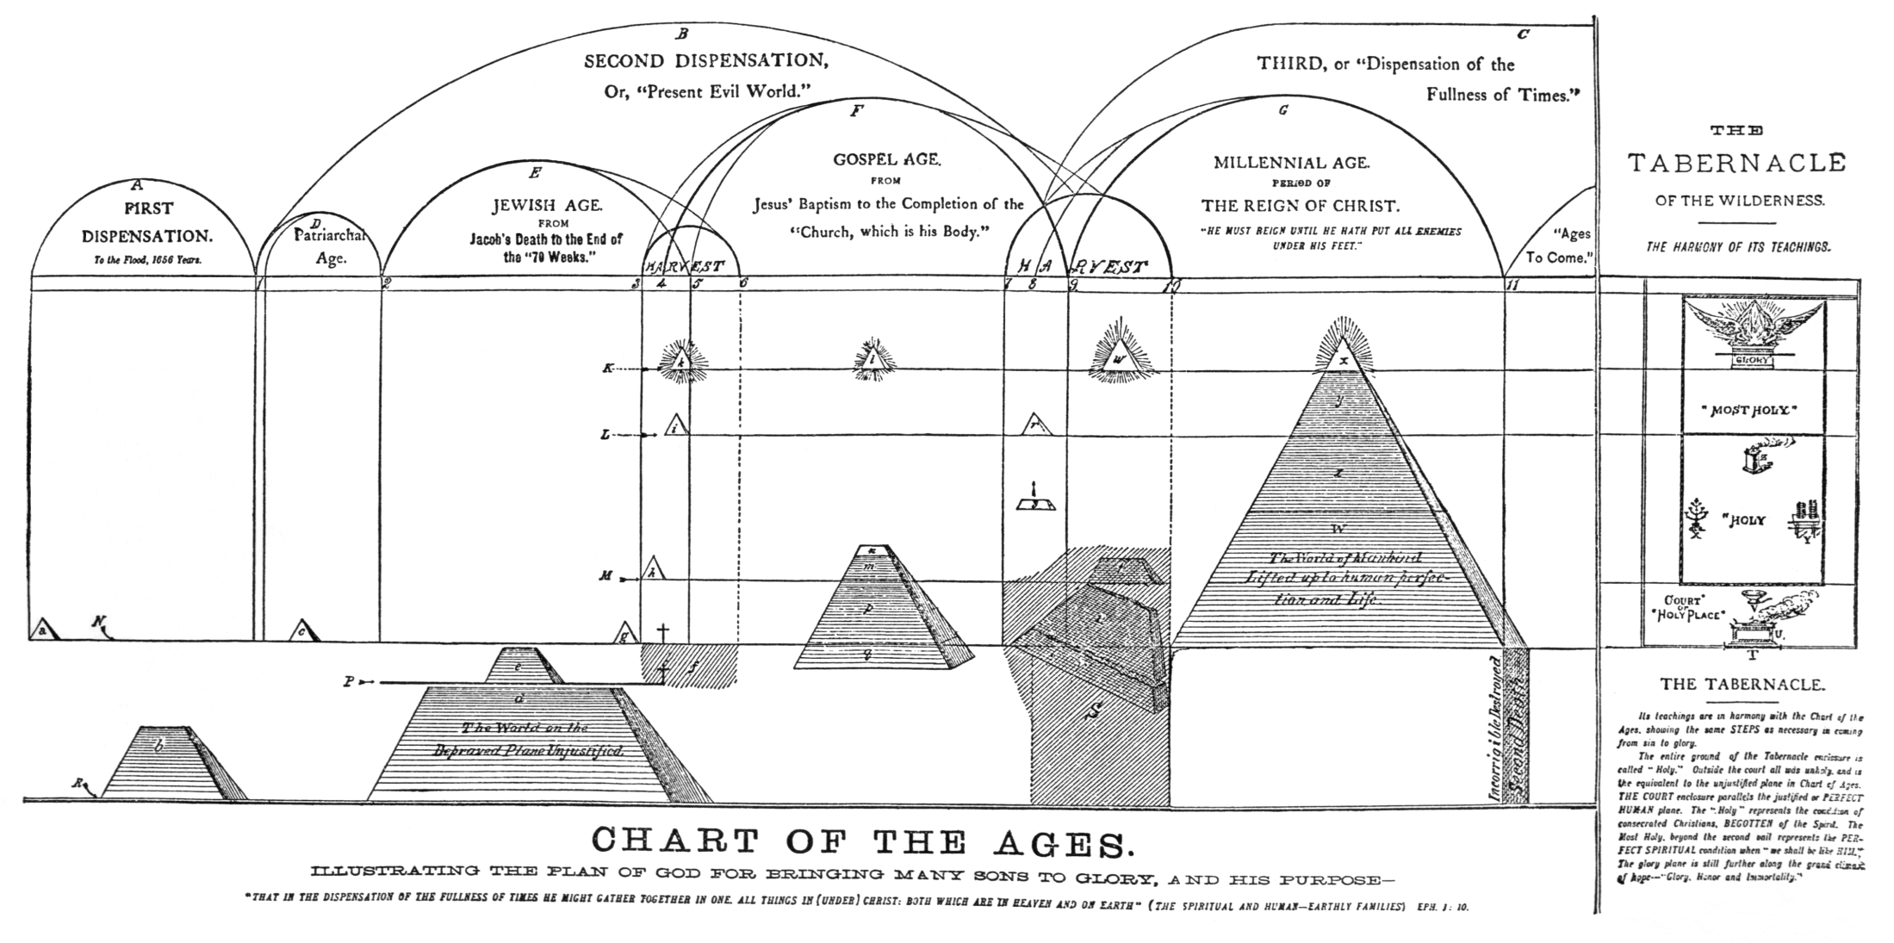
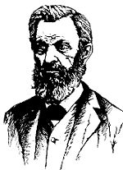
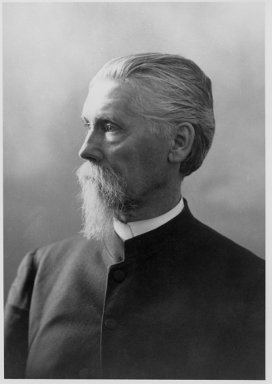
C.T. Russell:
1877 Object & Manner
1881 Tabernacle Shadows
1881 Food for Thinking Christians
1886 Millennial Dawn
Keith
A.P. Adams
A.D. Jones
N.H Barbour J.H. Paton

Slide 20

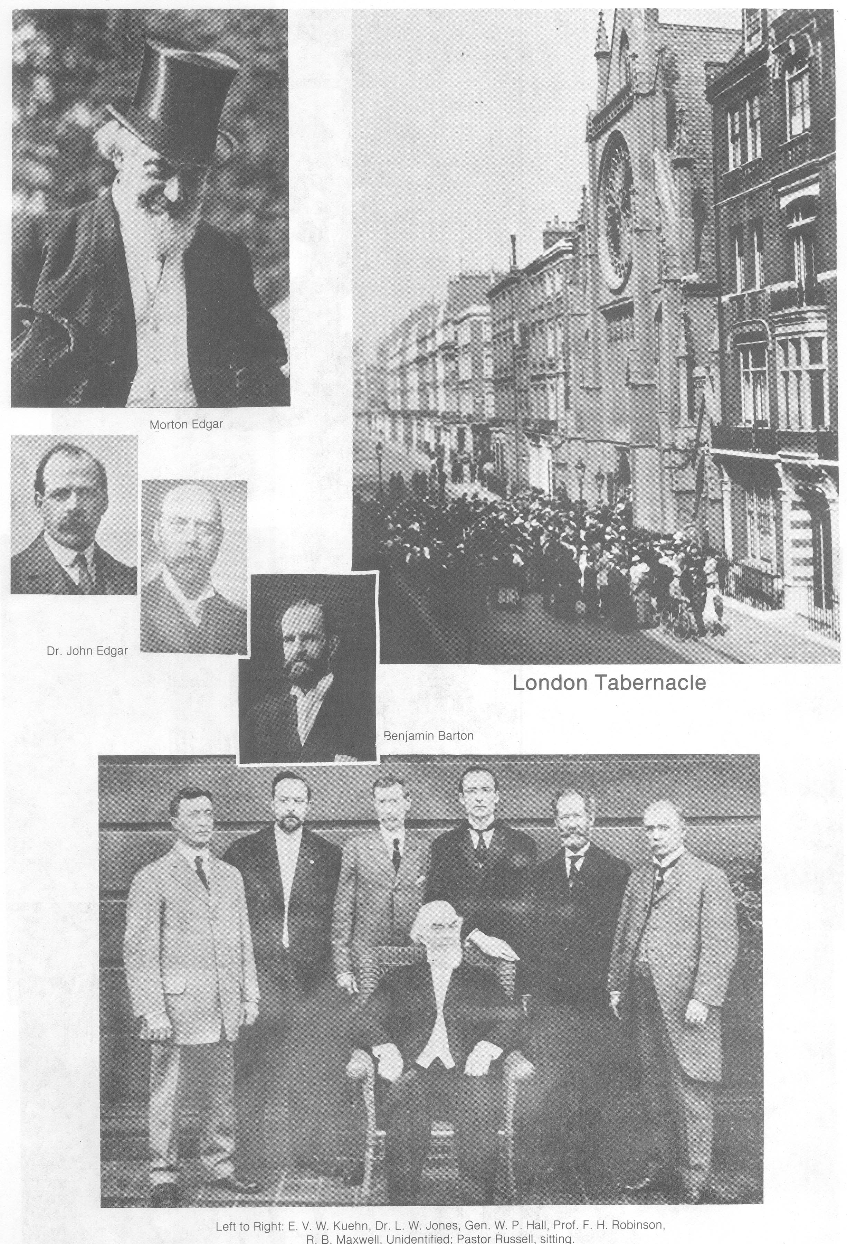
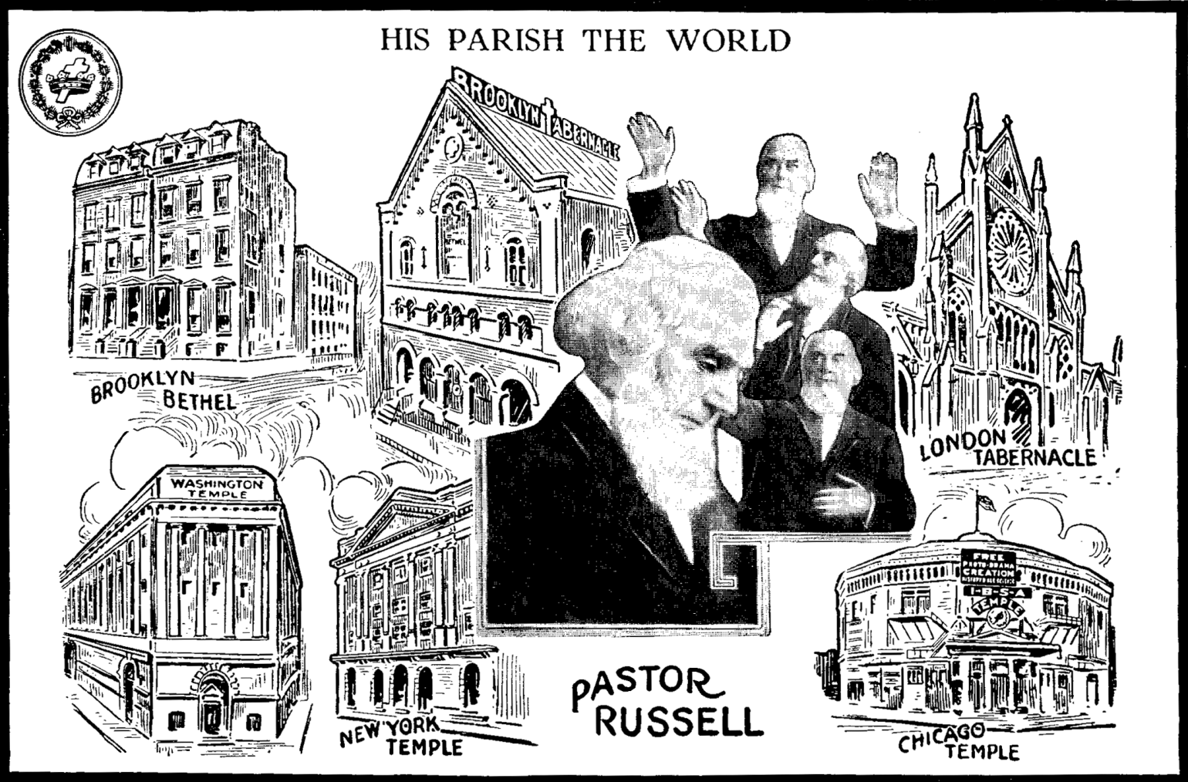
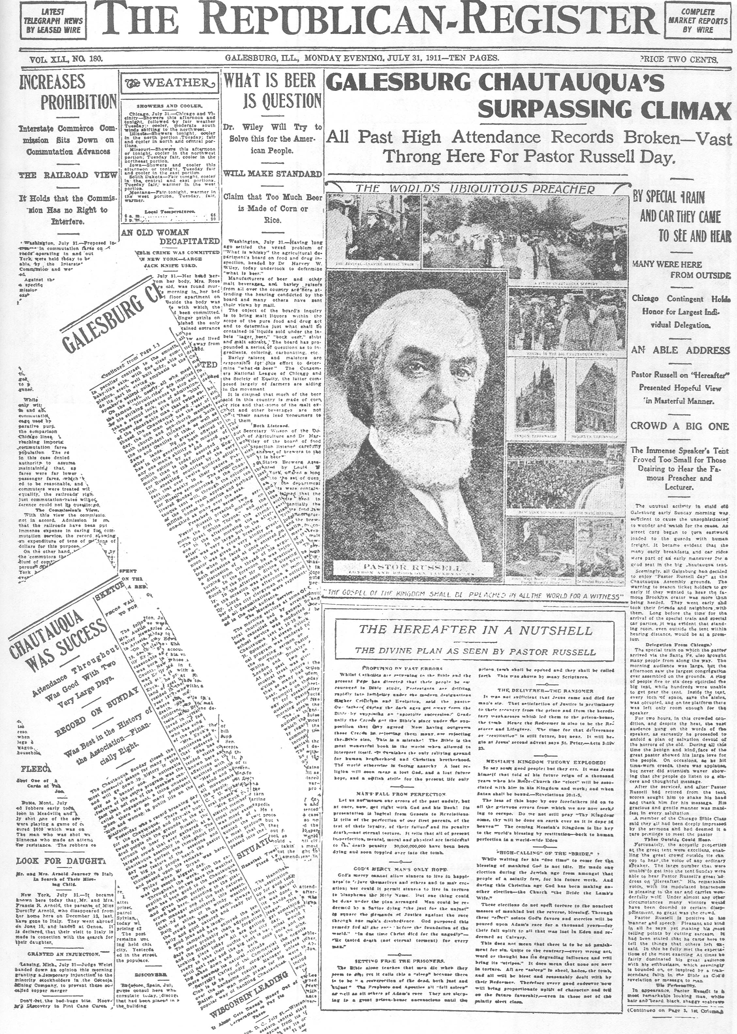
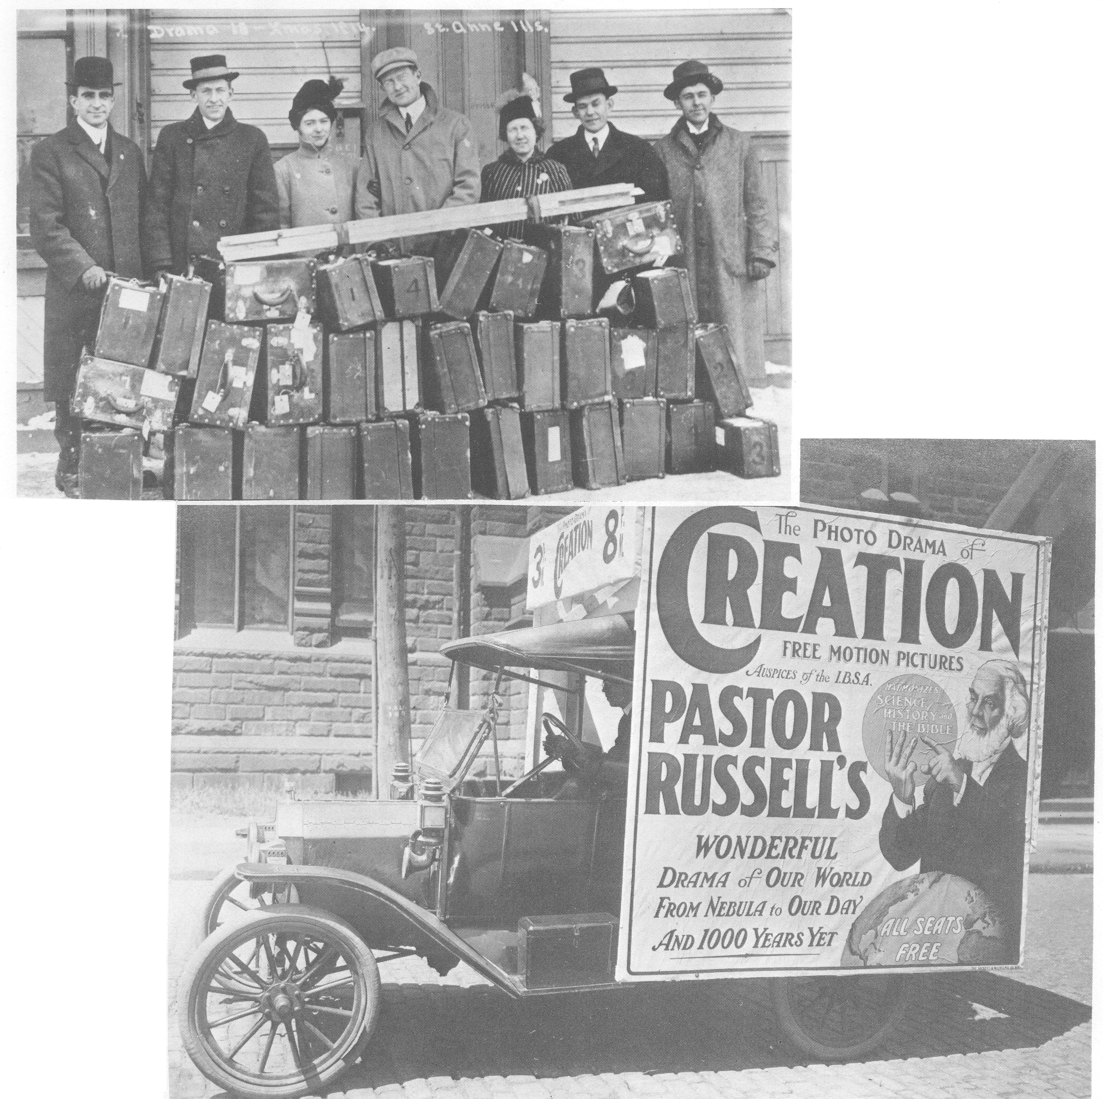

Slide 21
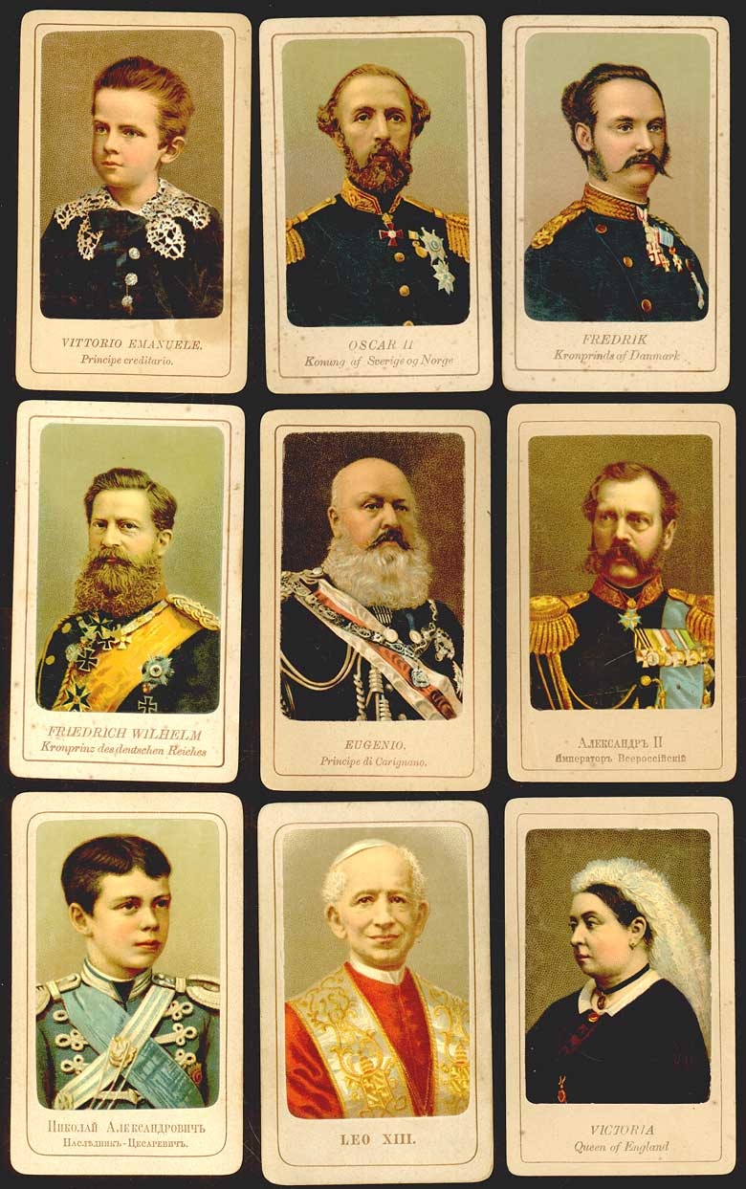

Slide 22
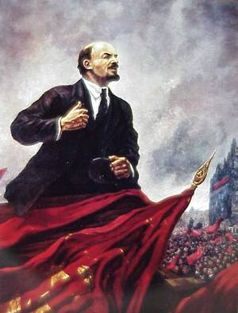




Slide 23
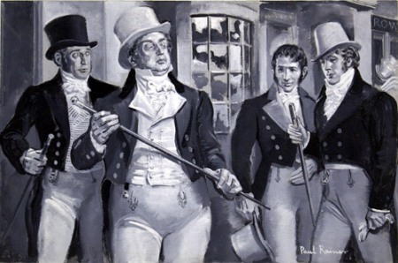


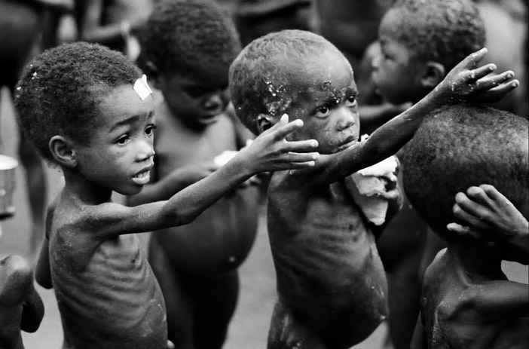
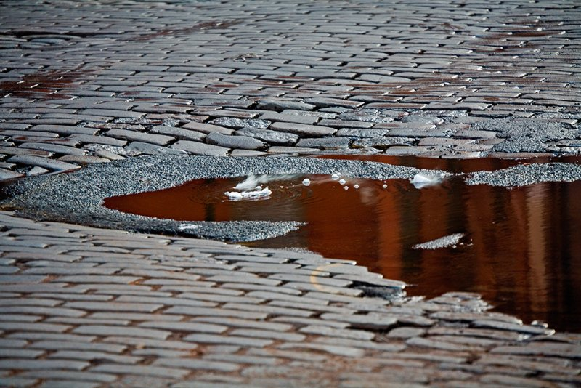

Slide 24

Rev 3:17; 18:7 "I am rich, and increased with goods, and have need of nothing. I sit as a queen, and am no widow, and shall see no sorrow."
Yet she is poor, blind and naked.

Slide 25
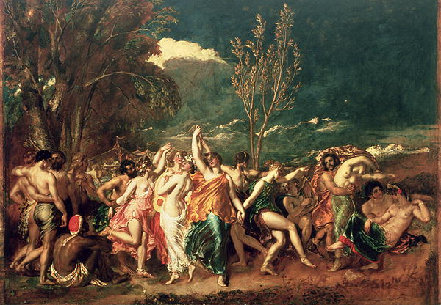
Matt 24:30-35
clouds of heaven,
all tribes of earth mourn,
gathering his elect,
this generation,
heaven and earth shall pass away

Slide 26
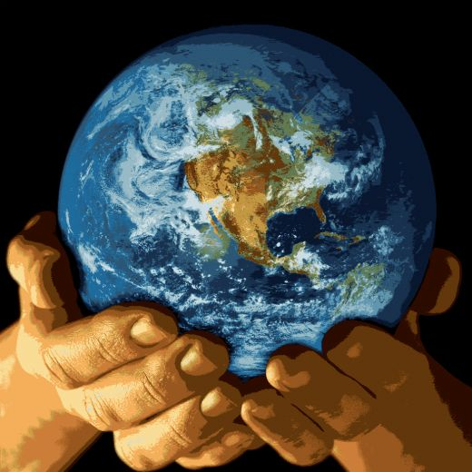



Slide 27
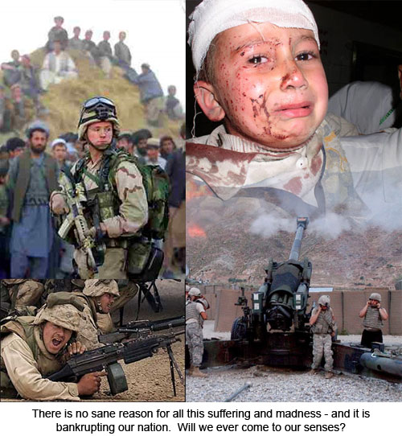
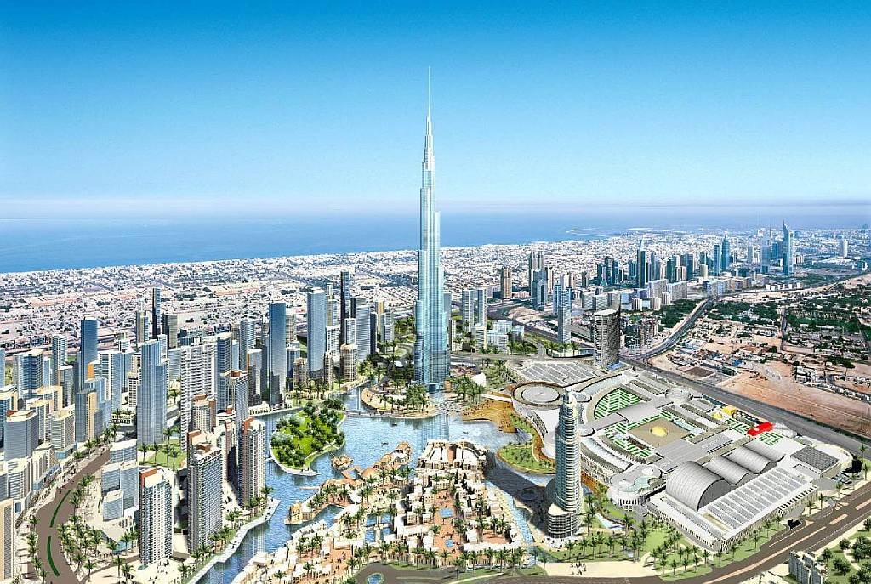
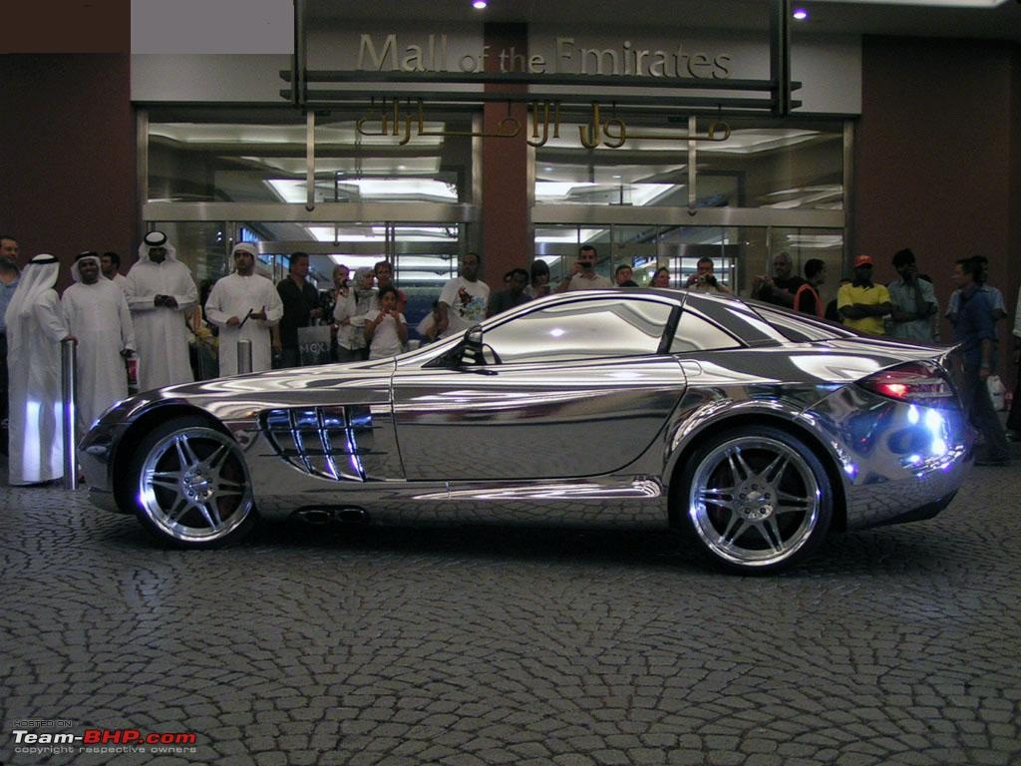
Dubai

Slide 28
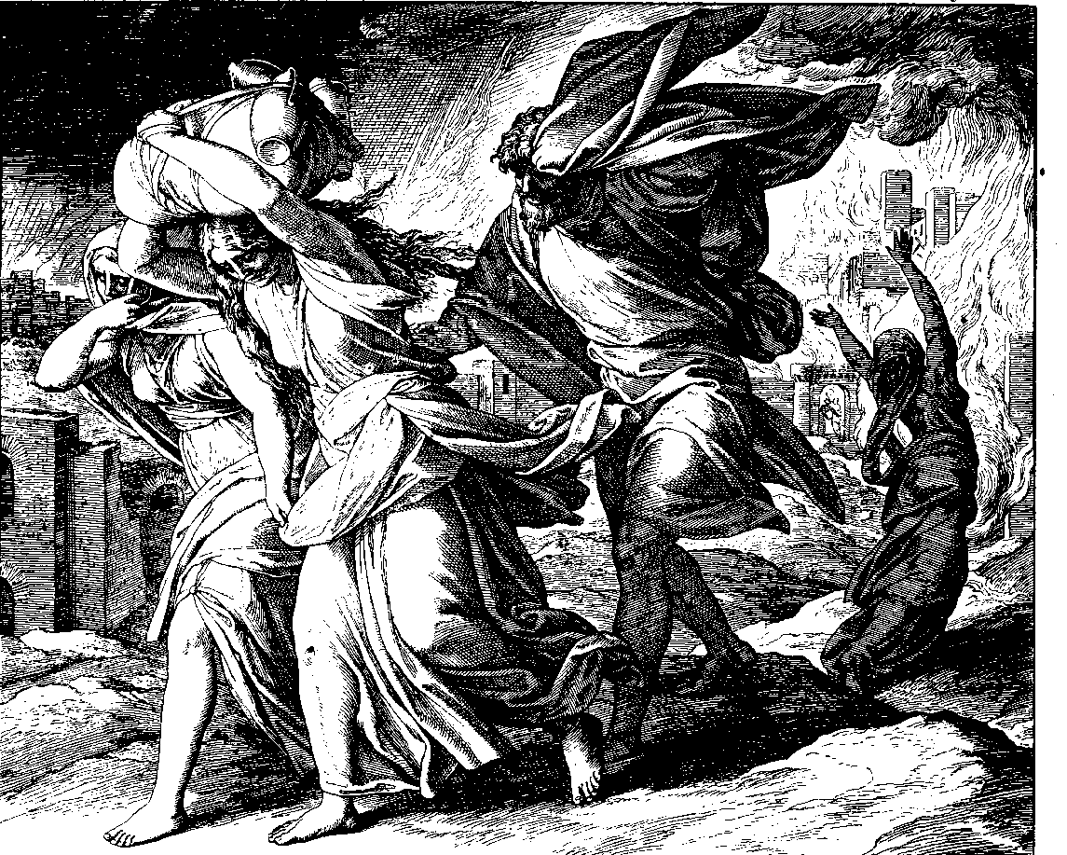
Luk 17:28-29 Likewise also as it was in the days of Lot; they did eat, they drank, they bought, they sold, they planted, they builded. But the same day that Lot went out of Sodom it rained fire and brimstone from heaven, and destroyed them all.
Jude 1:7 Even as Sodom and Gomorrha, and the cities about them in like manner, giving themselves over to fornication, and going after strange flesh, are set forth for an example…

Slide 29
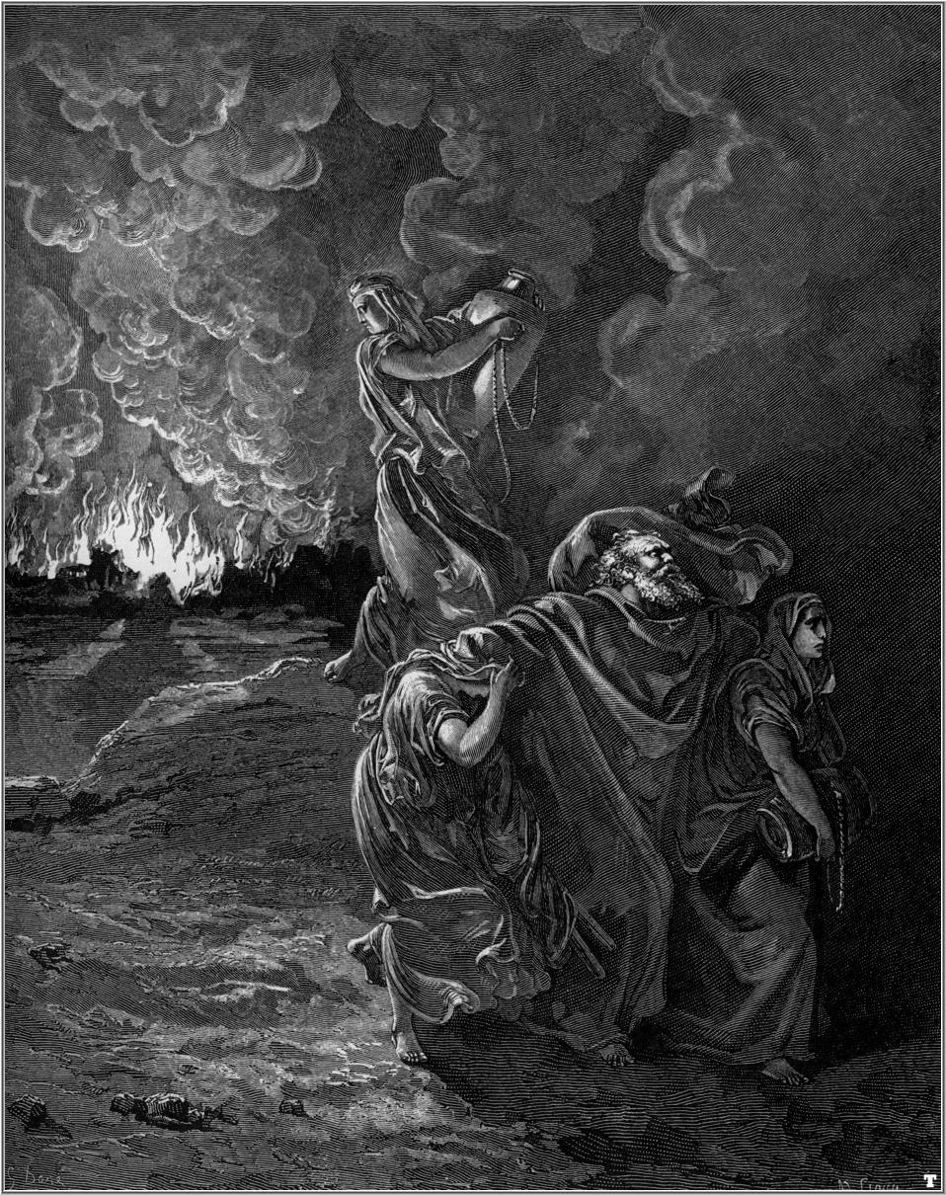
2 Peter 2:6
And turning the cities of Sodom and Gomorrha into ashes condemned them with an overthrow, making them an ensample unto those that after should live ungodly
Luke 17:30, 32
Even thus shall it be in the day when the Son of man is revealed (Apokalupsis)…
Remember Lot's wife.

Slide 30
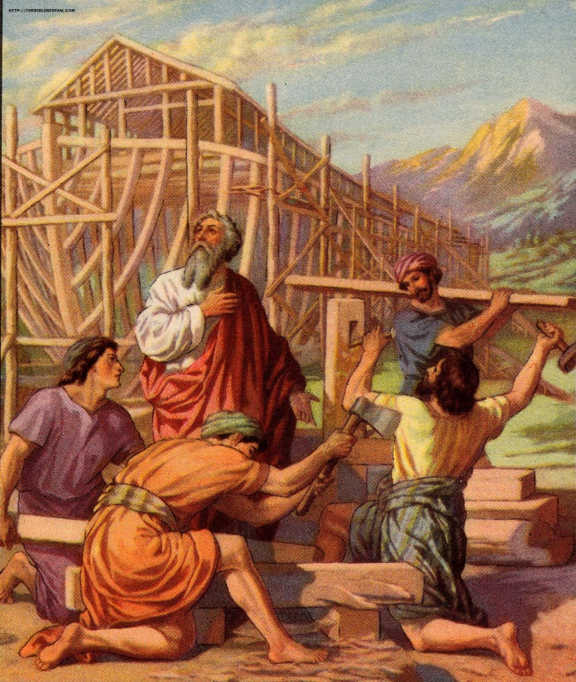
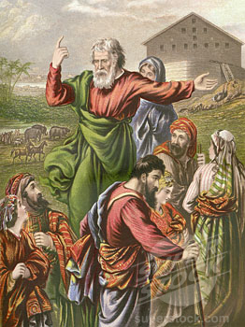
Heb 11:7 By faith Noah, being warned of God of things not seen as yet
2 Peter 2:5 a preacher of righteousness
2 Peter 3:3-6 There shall come in the last days scoffers… Whereby the world that then was, being overflowed with water, perished.
1 Peter 3:20-21 Which sometime were disobedient, when once the longsuffering of God waited in the days of Noah, while the ark was a preparing, wherein few, that is, eight souls were saved by water.
The like figure whereunto even baptism

Slide 31
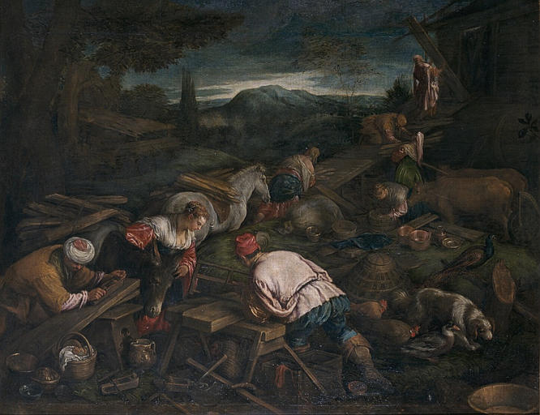


Slide 32
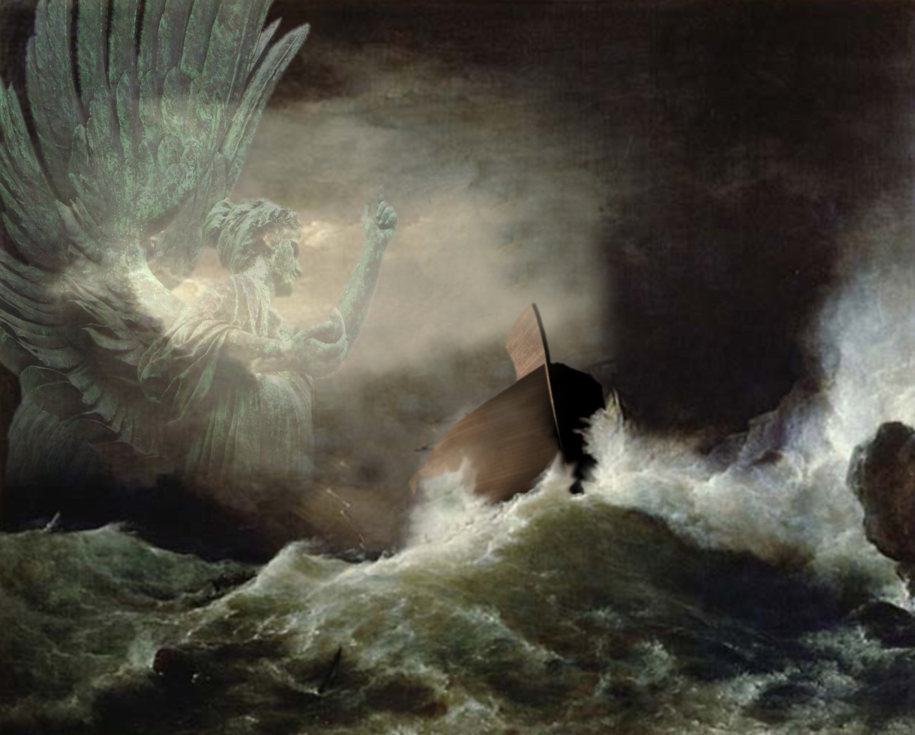

Slide 33


Gen 8:20 And Noah builded an altar unto the LORD; and took of every clean beast, and of every clean fowl, and offered burnt offerings on the altar.

Slide 34

Gen 9:12,16 And God said, This is the token of the covenant which I make between me and you and every living creature that is with you, for perpetual generations: … that I may remember the everlasting covenant…
Jer 31:28 Like as I have watched over them, to pluck up, and to break down, and to throw down, and to destroy, and to afflict; so will I watch over them, to build, and to plant, saith the LORD.

Slide 35

Mat 24:27 For as the lightning cometh out of the east, and shineth even unto the west;
so shall also the parousia of the Son of man be.
Mat 24:37 As the days of Noe were [before the flood],
so shall also the parousia of the Son of man be.
Mat 24:39 They knew not until the flood came, and took them all away; so shall also the parousia of the Son of man be.
Mat 24:30 They shall see the Son of man coming (erchomai) in the clouds of heaven with power and great glory.

Slide 36




Slide 37





Slide 38



1 Thess 3:12-13
The Lord make you to increase and abound in love one toward another, and toward all, even as we do toward you. To the end he may stablish your hearts unblamable in holiness before God, even our Father, at the parousia of our Lord Jesus Christ with all his saints
2 Peter 3:10-14
The day of the Lord will come as a thief, in which the heavens shall pass away with a great noise, and the elements shall melt with fervent heat

