Slide 1
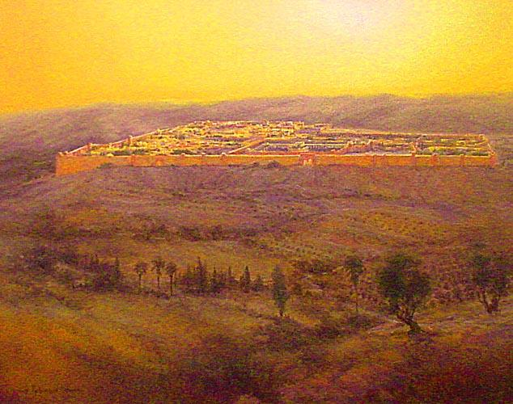
The Holy City

Slide 2
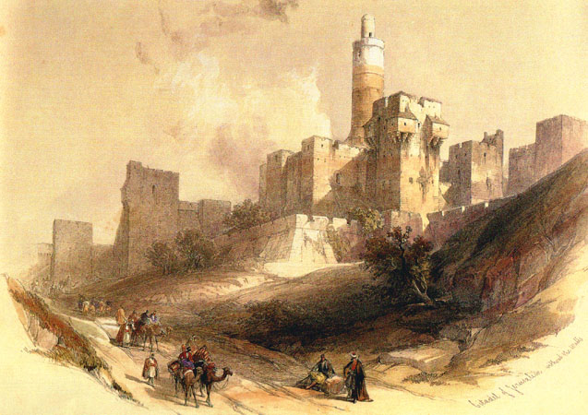
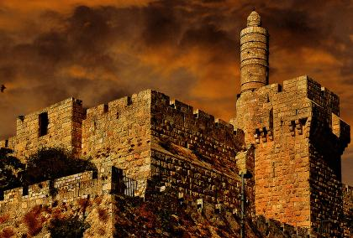
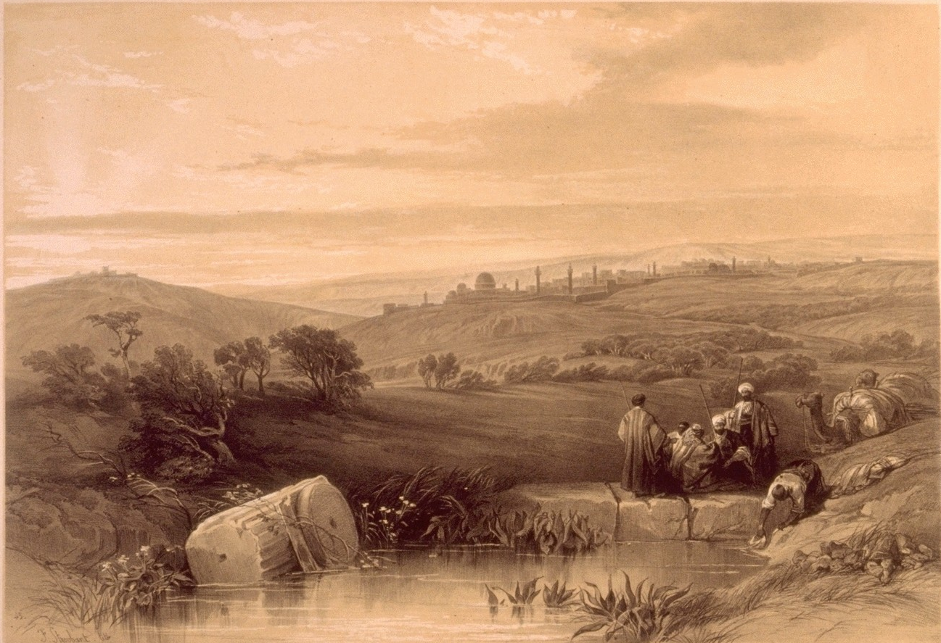
Isa 48:2
For they call themselves after the holy city, and stay themselves on the God of Israel
Psa 46:4
There is a river, the streams whereof shall make glad the city of God, the holy place of the tabernacles of the most High.

Slide 3
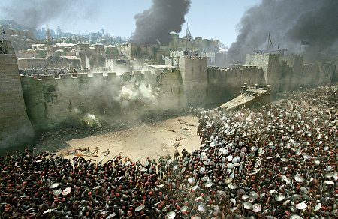
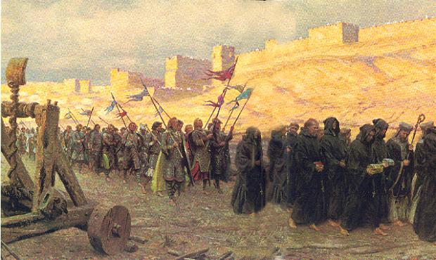

Slide 4
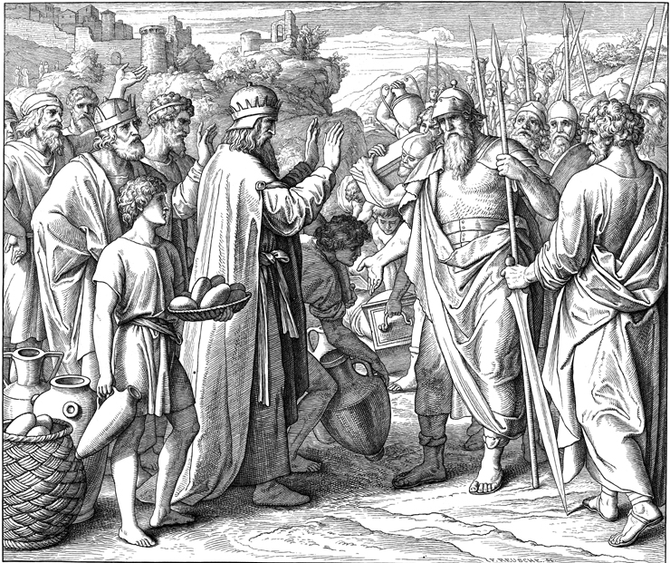
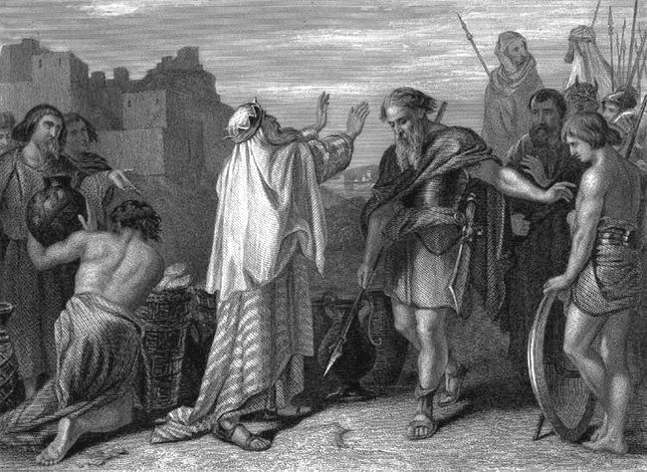
Melchizedek
Genesis 14:18

Slide 5
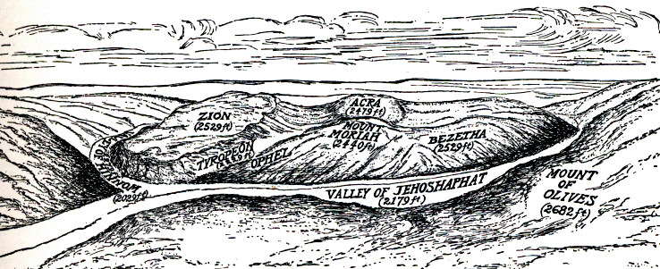
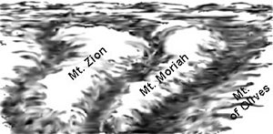

Slide 6
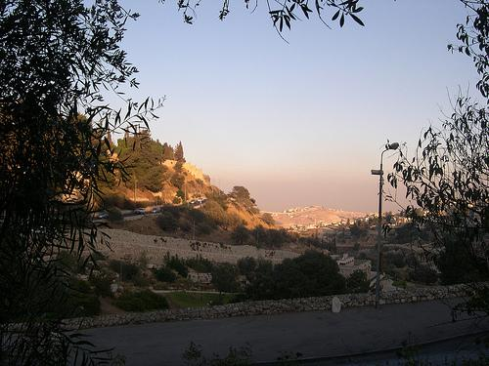
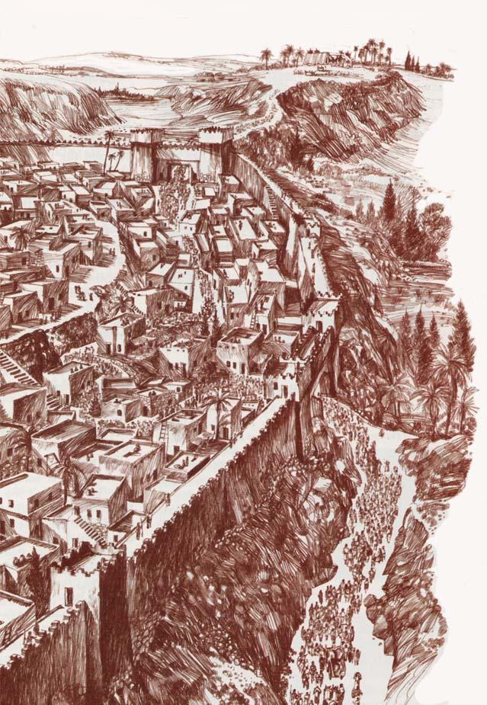
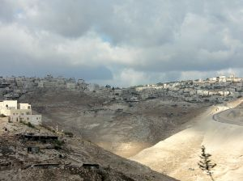
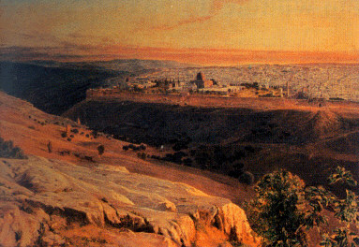
Jebusites ~ Genesis 10:15-16

Slide 7
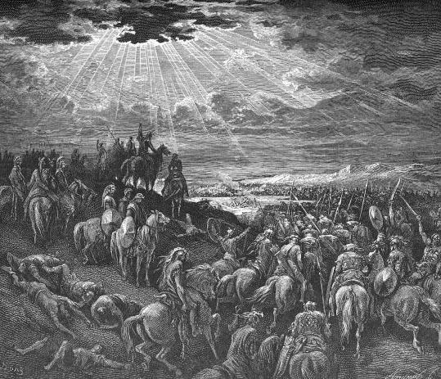
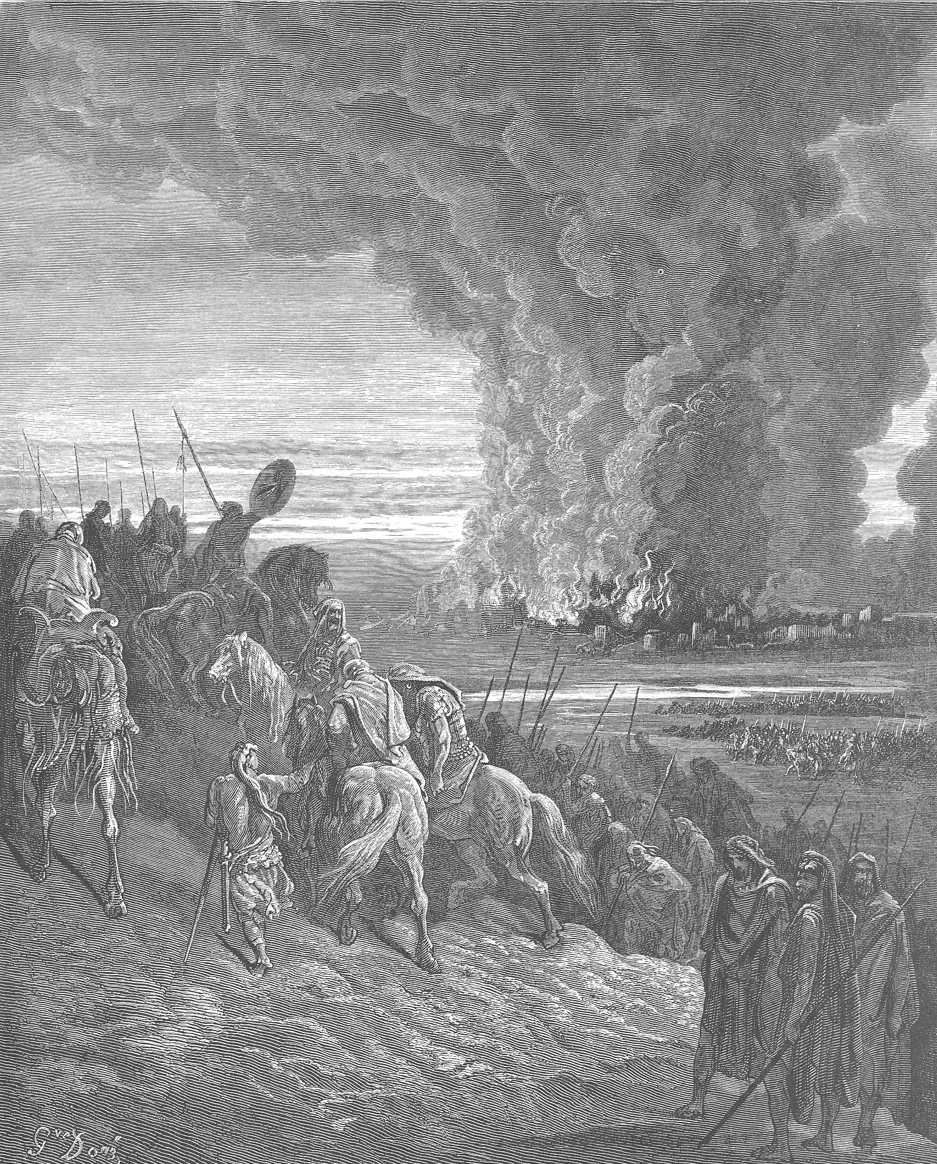
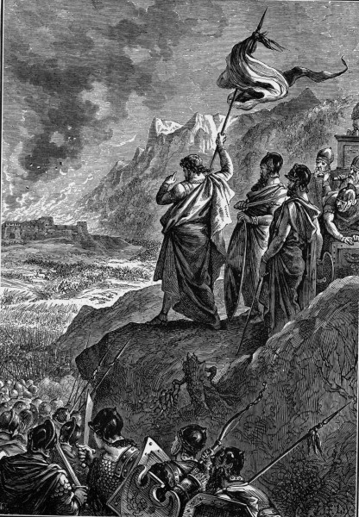
Judges 1:1-9 the men of Judah fought against Jerusalem and captured it and struck it with the edge of the sword and set the city on fire
Josh 10:8-11 Do not fear them,
for I have given them into your hands

Slide 8
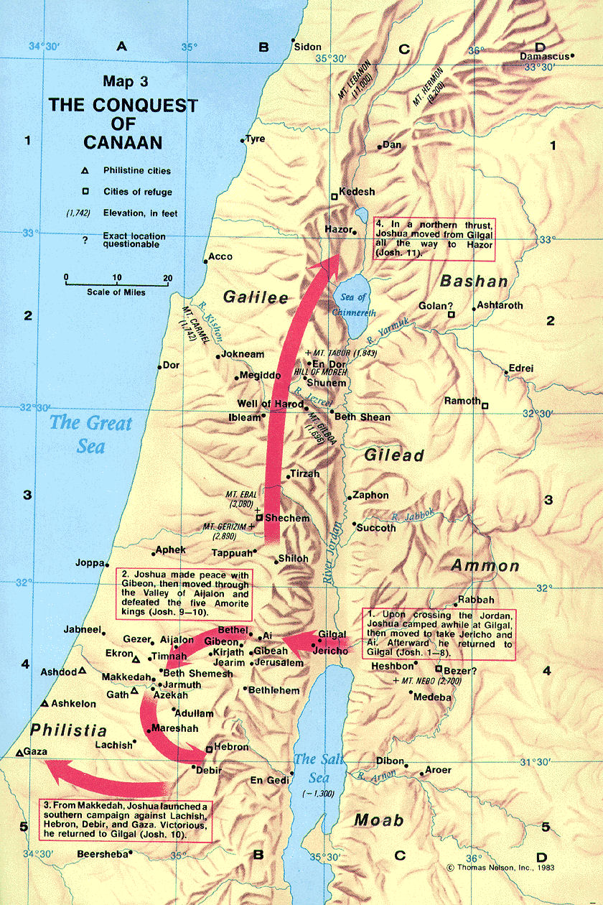

Slide 9
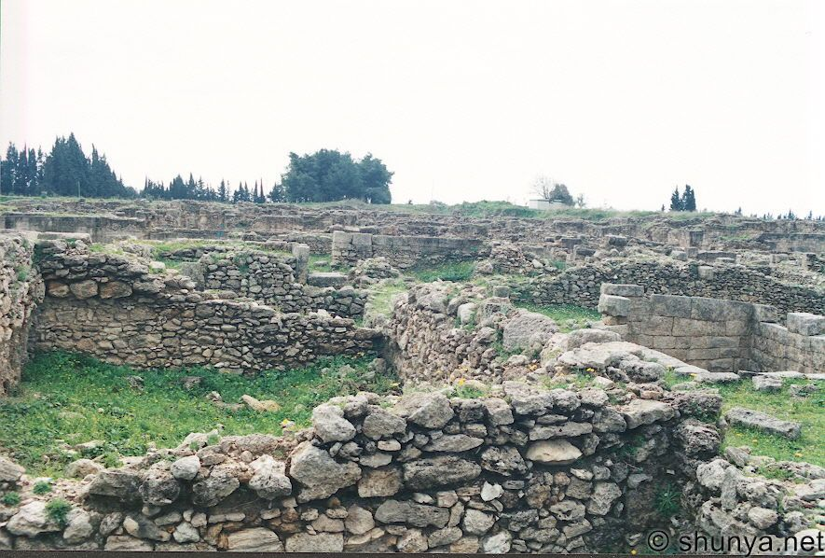
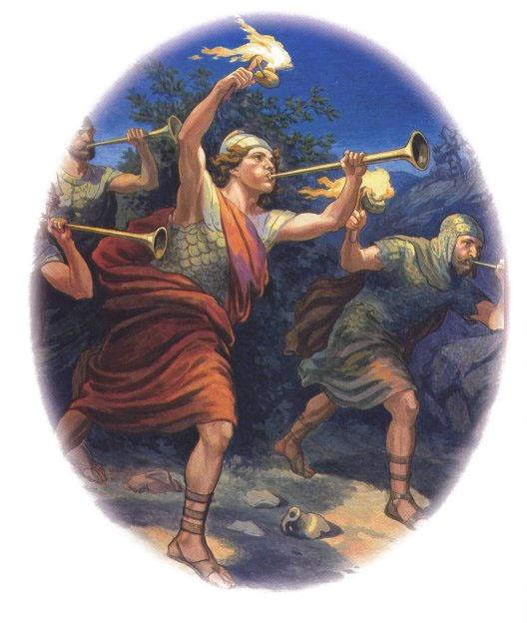
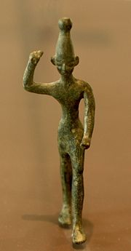
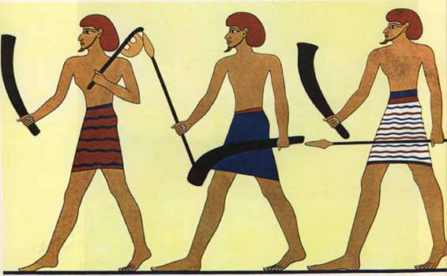
Joshua 1:9 Be strong and courageous. Do not be frightened, and do not be dismayed, for the LORD your God is with you wherever you go.
Num 33:55-56
them whom you let remain shall be as barbs in your eyes and thorns in your sides

Slide 10
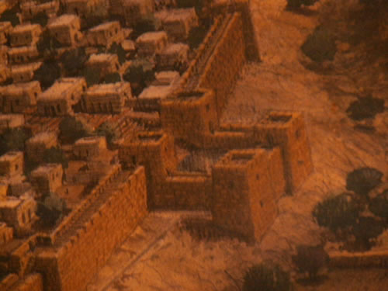
2 Sam 5:6-10
And the king and his men went to Jerusalem against the Jebusites, the inhabitants of the land, who said to David, “You will not come in here, but the blind and the lame will ward you off”--thinking, “David cannot come in here.
Nevertheless, David took the stronghold of Zion

Slide 11
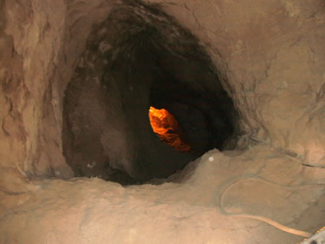
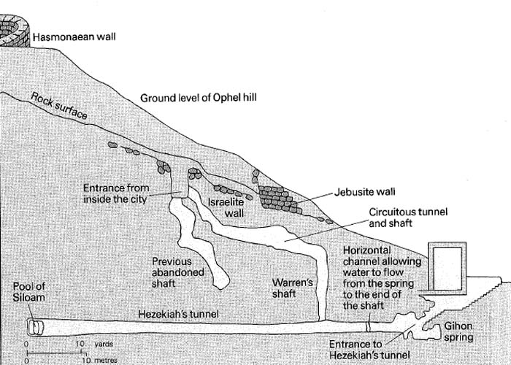
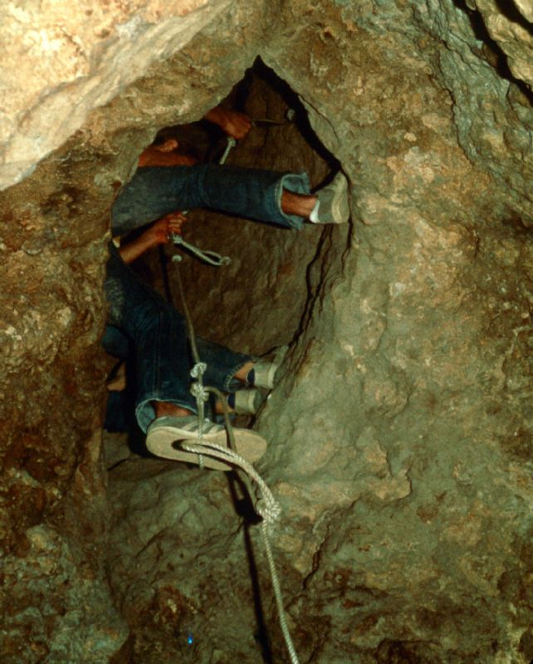
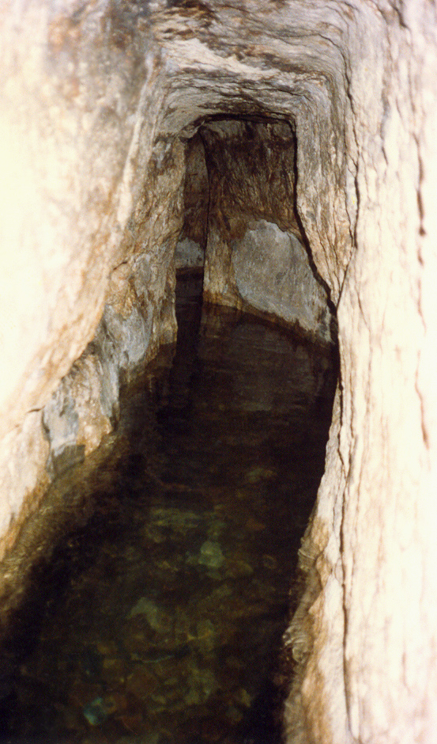

Slide 12
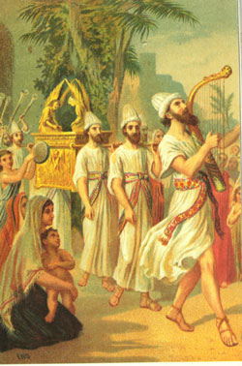
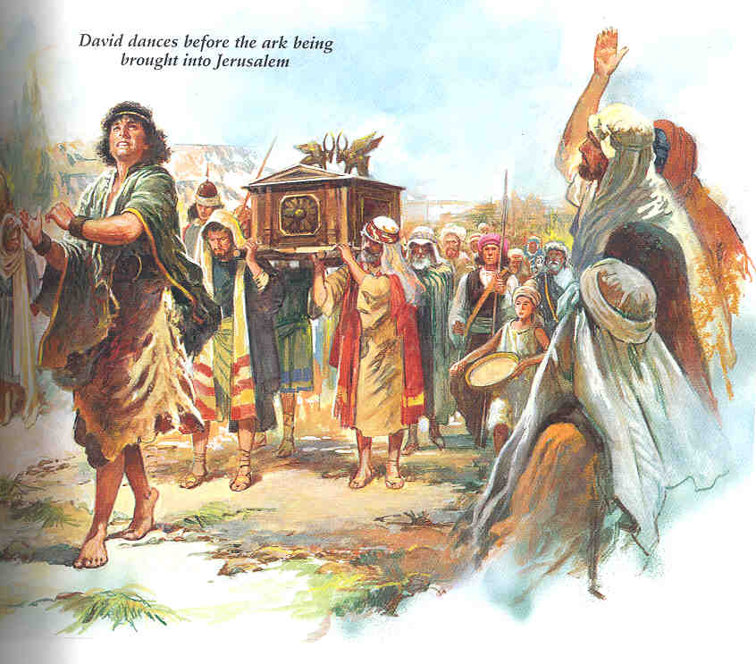
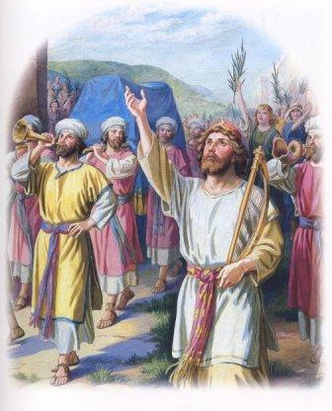

Slide 13
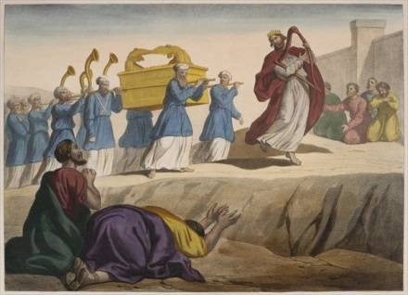
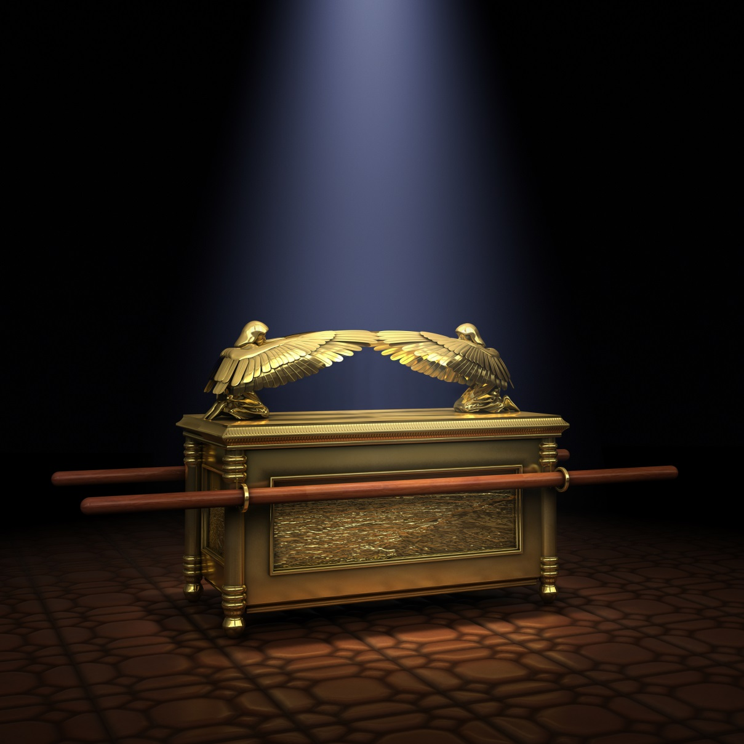

Slide 14
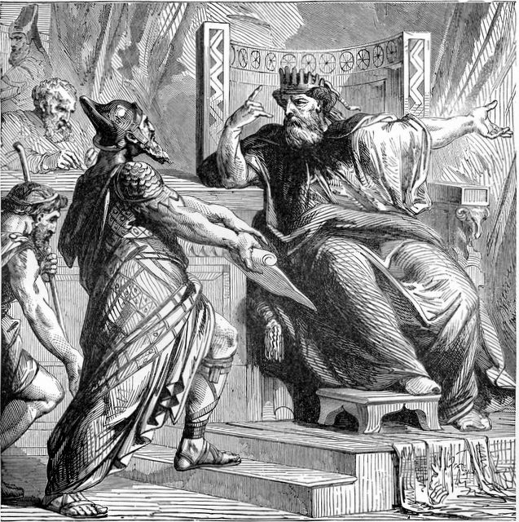
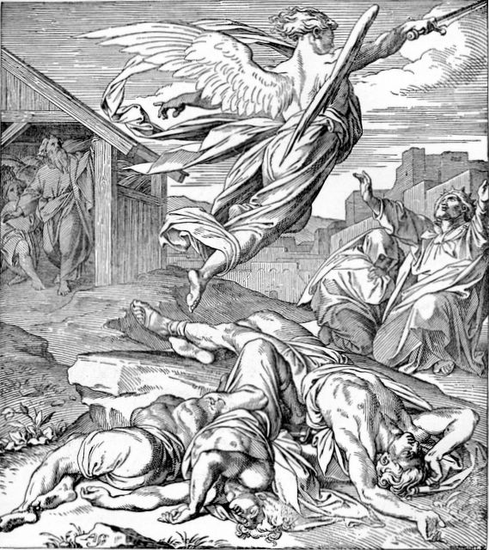
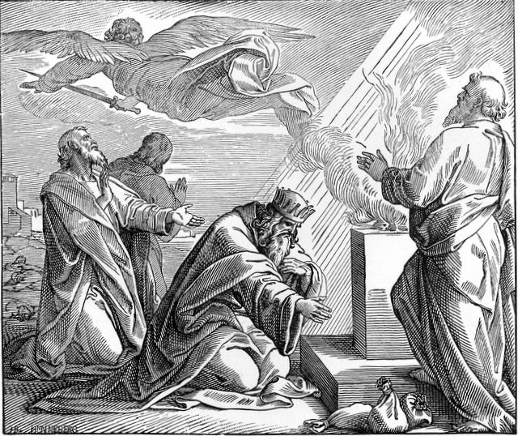
1Chron 21:1, 7
Satan provoked David to number Israel…and God was displeased with this thing

Slide 15
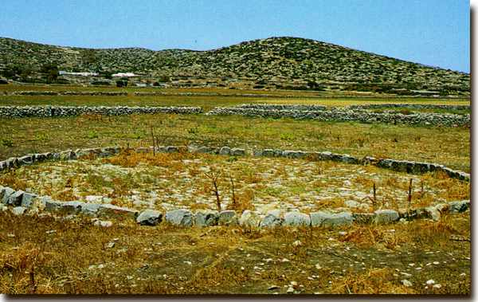
1Chron 21:24 King David said to Ornan,
“No, but I will buy it for the full price.
I will not take for the LORD what is yours,
nor offer burnt offerings that cost me nothing.”

Slide 16
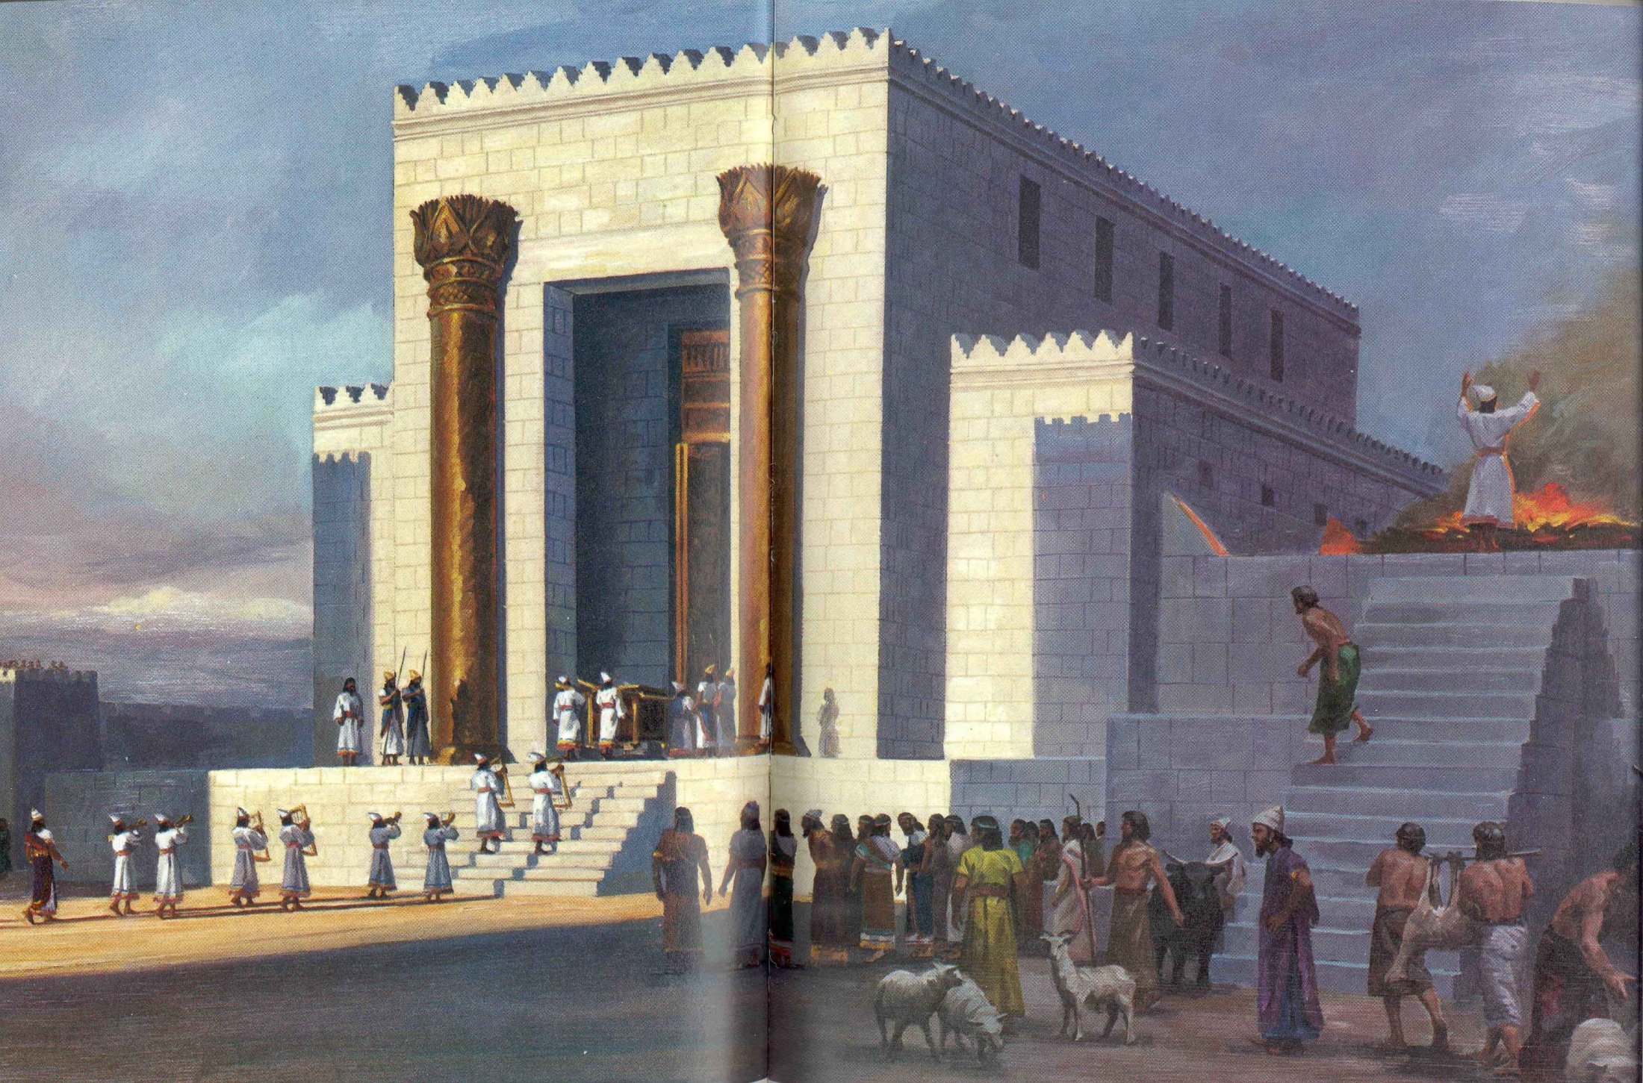

Slide 17
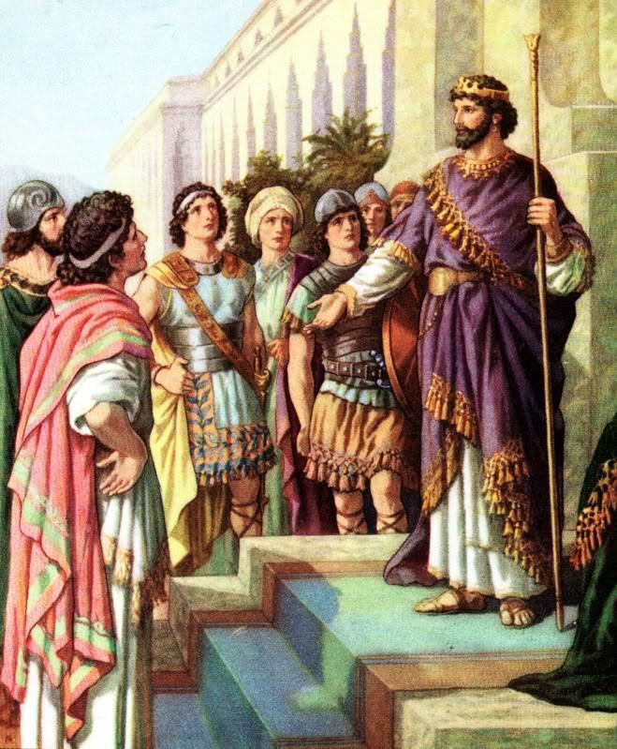
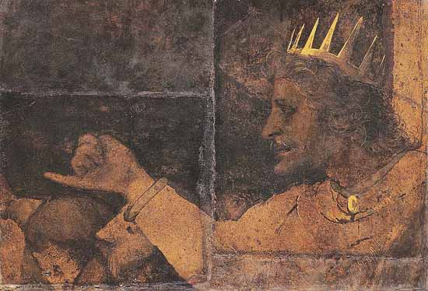
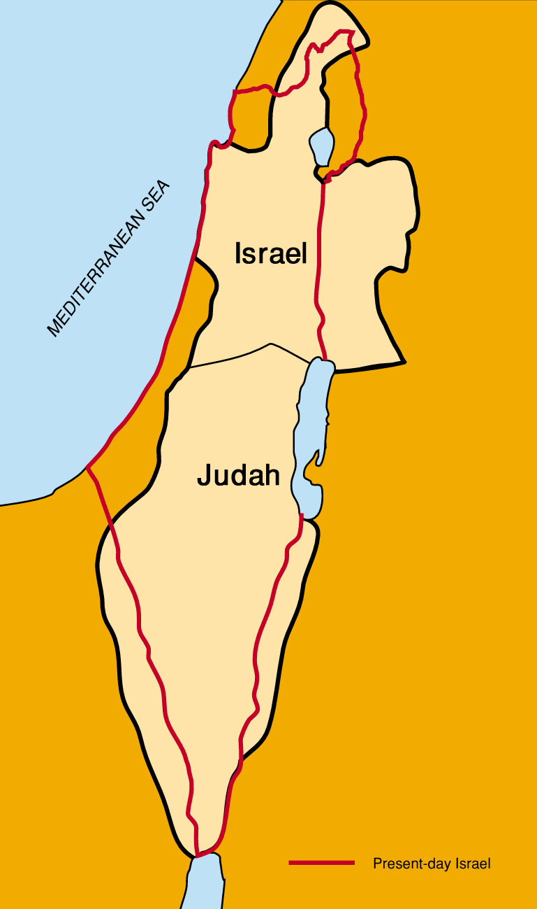
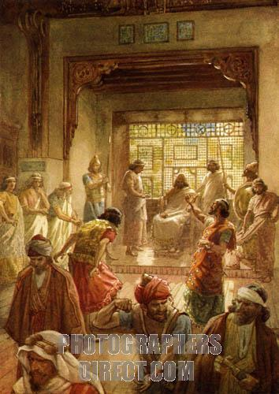
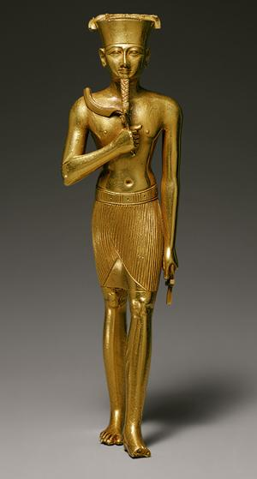
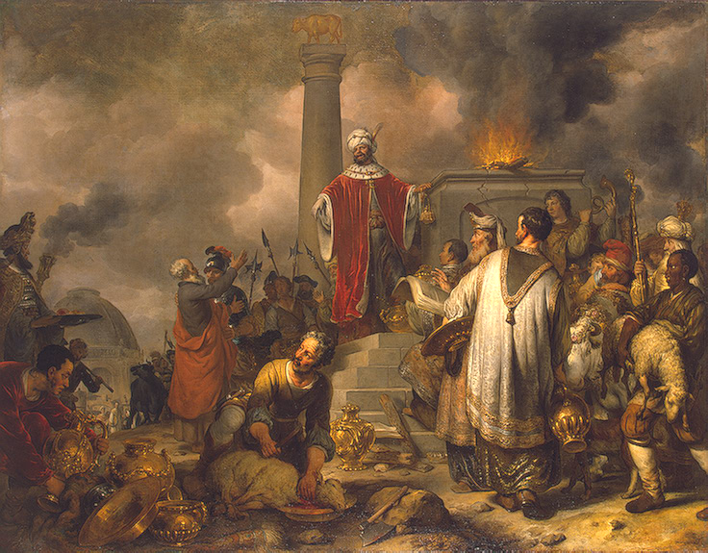
2Chron 12:1-12
He abandoned the law of the LORD, and all Israel with him. Shishak king of Egypt came up against Jerusalem . He took the fortified cities of Judah and came as far as Jerusalem. Nevertheless, they shall be servants to him.
Israel
Judah

Slide 18
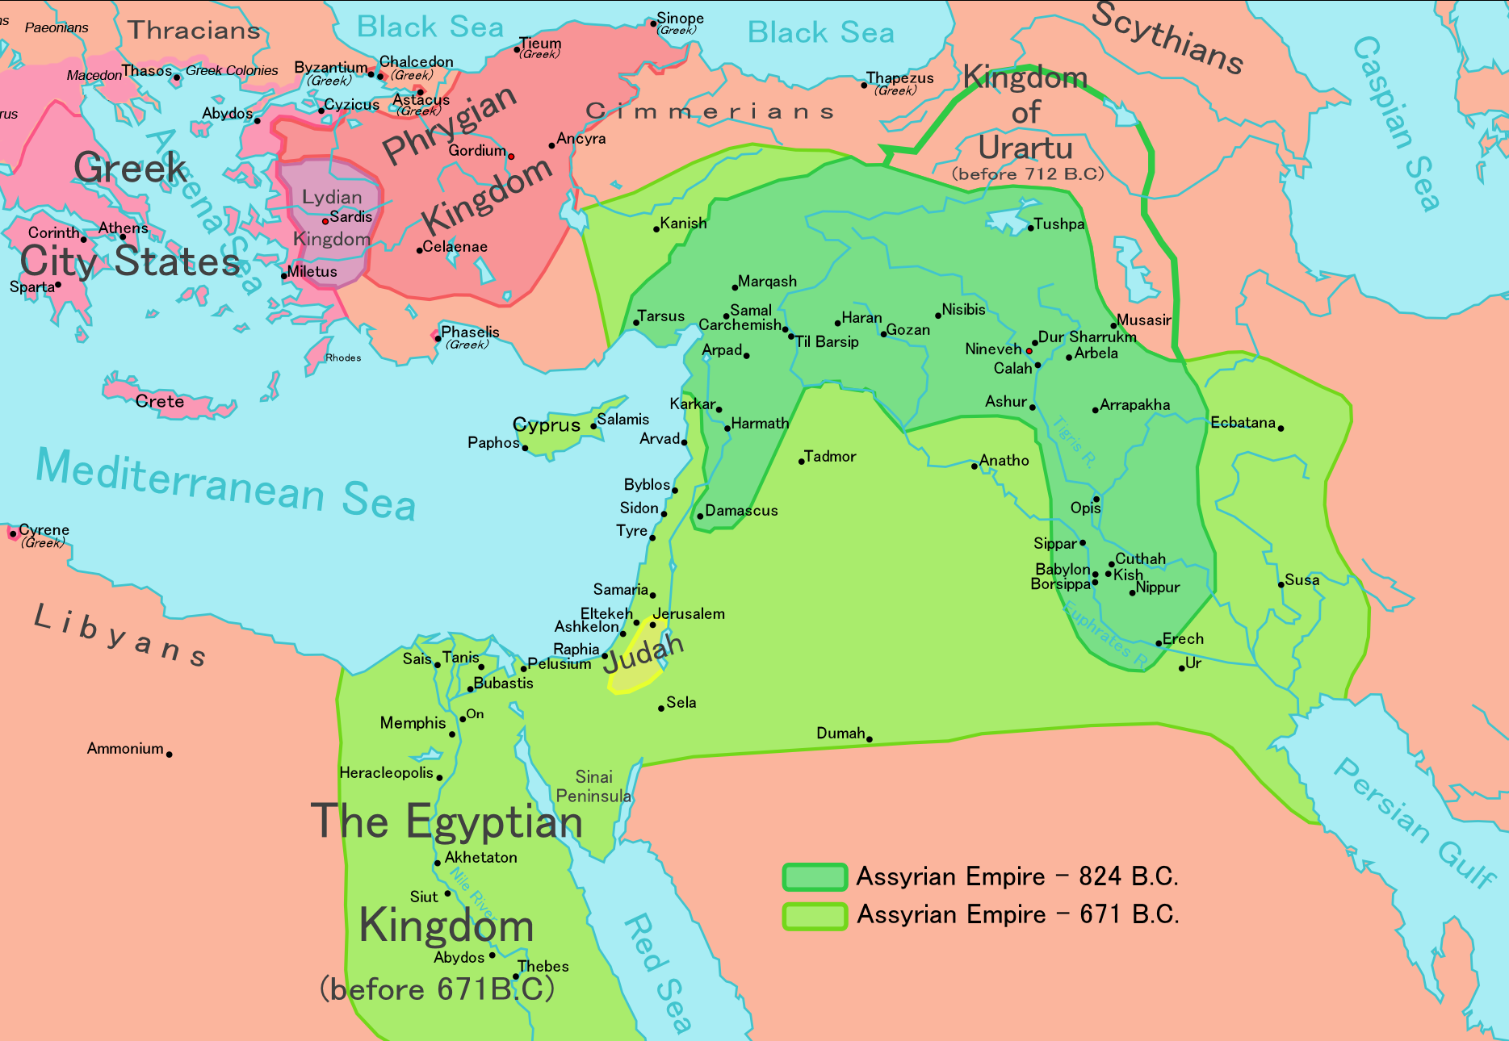

Slide 19
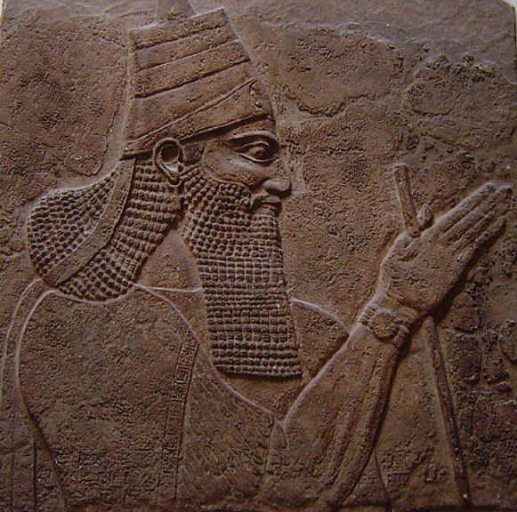
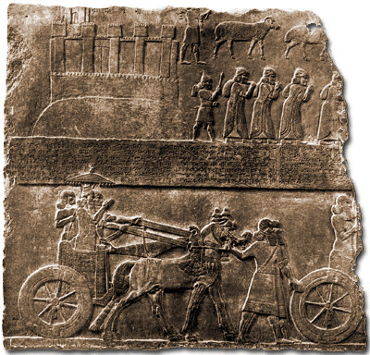
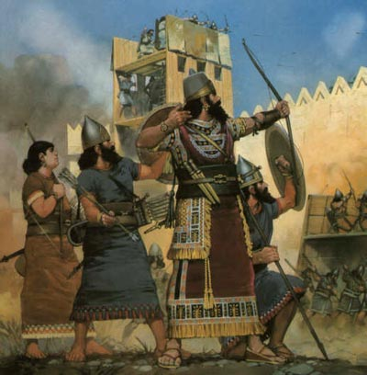
Isaiah 7:2

Slide 20
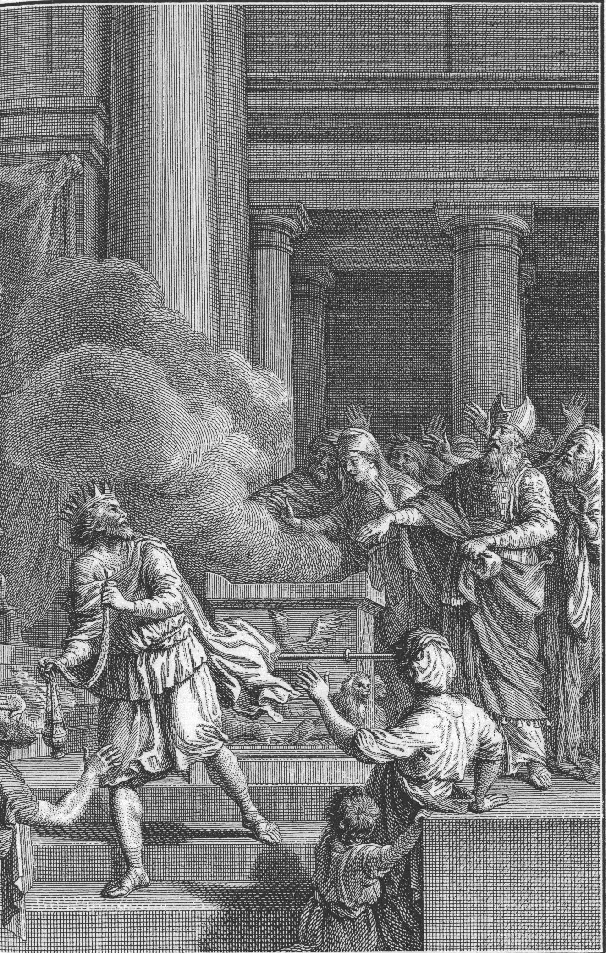
2 Chron 28:23-24
Ahaz gathered together the vessels of the house of God and cut in pieces the vessels of the house of God, and he shut up the doors of the house of the LORD, and he made himself altars in every corner of Jerusalem.

Slide 21
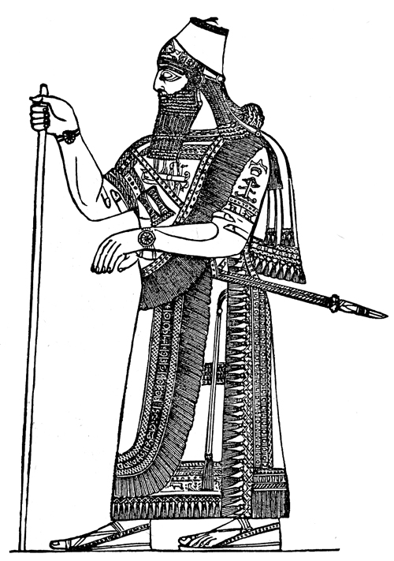
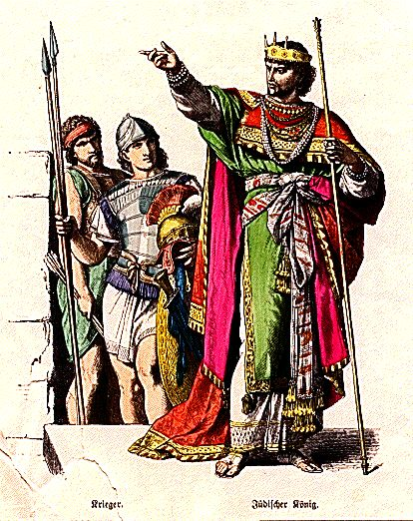
2 Kings 16:7-8
“I am your servant and son.”

Slide 22
2 Kings 20:20

Slide 24
2 Kings 18:13-16
And Hezekiah king of Judah sent to the king of Assyria (Sennacherib) to Lachish, saying, I have offended; return from me: that which thou puttest on me will I bear.
And the king of Assyria appointed unto Hezekiah king of Judah three hundred talents of silver and thirty talents of gold.

Slide 25
2 Kings 19:15-20
O LORD our God, save us, please, from his hand, that all the kingdoms of the earth may know that you, O LORD, are God alone
2 Kings 19:6-7
Thus says the LORD:
Do not be afraid because of the words that you have heard

Slide 28
Isa. 8:9-13
Associate yourselves … and ye shall be broken in pieces …
Take counsel together, but it will come to nothing; speak a word, but it will not stand …
“Do not call conspiracy all that this people calls conspiracy, and do not fear what they fear, nor be in dread.
But the LORD of hosts, him you shall honor as holy.
Let him be your fear, and let him be your dread.

Slide 32
Matt 23:37
O Jerusalem, Jerusalem, thou that killest the prophets, and stonest them which are sent unto thee, how often would I have gathered thy children together, even as a hen gathereth her chickens under her wings, and ye would not!

Slide 33
Isa 66:14
And when ye see this, your heart shall rejoice, and your bones shall flourish like young grass; and the hand of the LORD shall be known toward His servants, and He will have indignation
against His enemies.
Matt 24:2
there will not be left here one stone upon another that will not be thrown down.
~ Jer 26:18; Micah 3:12

Slide 34
Petah Tikva 1878 - 2010

Slide 35
Isa 49:6
I will also give thee for a light to the Gentiles, that thou mayest be my salvation unto the end of the earth.
(Isa 42:6; 60:3)

Slide 36
Ezek 20, 38
Zech 12, 14

